Slide 1
Introduction to Bioinformatics
Michaela Matthews
Bioinformatician

Slide 2
Sequencing introduction
Long-read analysis - EPI2ME
Other analysis tools

Slide 3
Sequencing introduction

Slide 4
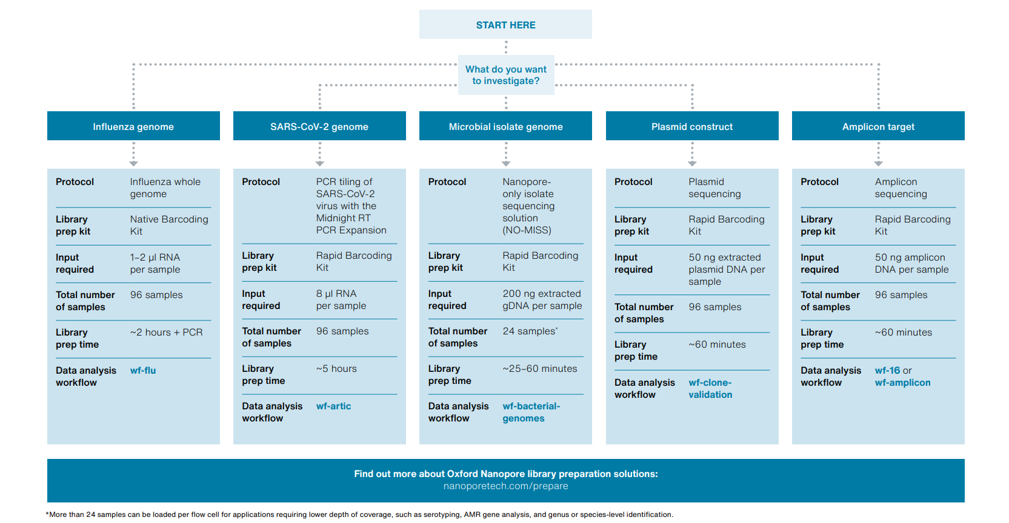
Sequencing steps

Slide 5
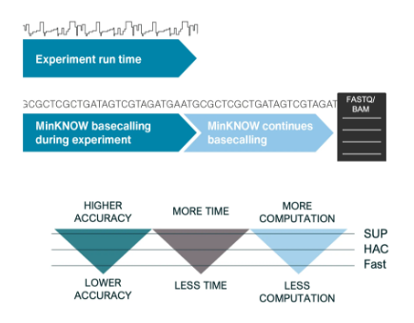
Sequencing steps
Electrical signals as DNA passes through pore
Transforms signal into base sequence (MinKNOW)
3 models: Fast, high accuracy (HAC) and super accurate (SUP)
Separates clusters into samples
Raw data
Basecalling
Demultiplexing

Slide 6
File formats
There are a lot of different file formats created during sequencing and bioinformatic analysis:
Format | Description
FAST5/POD5 | A format used by Oxford Nanopore Technologies (ONT) for storing raw sequencing data produced by their nanopore sequencing platforms.
FASTQ | A format for representing both nucleotide sequences and their corresponding quality scores. Each record contains a sequence and quality scores in a readable text format.
BAM (Binary Alignment/Map) | A binary version of the sequence alignment data, which is more compact and efficient for large datasets.
FASTA | A text-based format for representing nucleotide or protein sequences. Each sequence is represented by a header line starting with '>', followed by the sequence data.

Slide 7
FASTQ files
A format for representing both nucleotide sequences and their corresponding quality scores. Each record contains a sequence and quality scores in a readable text format.
FASTQs can either be from:
Single-read run - R1 per sample
Paired-read run - R1 and R2 per sample

Slide 8
FASTQ files
Header/Identifier line (starts with '@'): This line contains information about the sequence, often including a unique identifier, sequencing machine information, and other metadata
Sequence line: This line contains the actual sequence of DNA or RNA bases represented by letters (A for Adenine, T for Thymine, C for Cytosine, G for Guanine, and N for ambiguous bases)
Quality score header line (starts with '+'): This line is usually just a placeholder and is often identical across all sequences in the file
Quality scores line: Has a string of characters which represent the quality scores associated with each base of the nucleic sequence; must have the same number of characters as line 2

Slide 9
FASTQ Quality scores
The Phred quality score is the probability of an incorrect base call
Higher scores = better
Phred Quality Score | Probability of incorrect base call | Base call accuracy
10 (Q10) | 1 in 10 | 90%
20 (Q20) | 1 in 100 | 99%
30 (Q30) | 1 in 1000 | 99.9%
40 (Q40) | 1 in 10,000 | 99.99%
50 (Q50) | 1 in 100,000 | 99.999%
60 (Q60) | 1 in 1,000,000 | 99.9999%

Slide 10
Short vs Long reads
Short e.g Illumina
Long e.g Oxford Nanopore
Cannot distinguish repetitive regions/low complexity
Higher error rate for base calling
Best of both worlds: Use both types of data together for analysis (Hybrid)

Slide 11
Different types of sequencing
Shotgun metagenomics
Amplicon (16S/18S)
Whole genome
Marker gene amplification
Genus level
Whole Salmonella genome
Strain level
Whole sample community
Species level

Slide 12
General analysis steps
Quality Control (QC)
Cluster/Assemble sequences
Identification (bacteria/genes/SNPs)
Visualise output

Slide 13

Software repositories
GitHub – hosts code for software
Documentation/Tutorials
Report issues with software
https://github.com/MMatthewsQ21/zim-training

Slide 14
Long-read analysis - EPI2ME

Slide 15


EPI2ME
https://labs.epi2me.io/
Existing bioinformatic workflows
Runs through Nextflow (workflow manager)
Run locally/Cloud
Input
Software 1
Output 1
Output 2
Software 2
Output 3
Software 3
Output 4

Slide 16
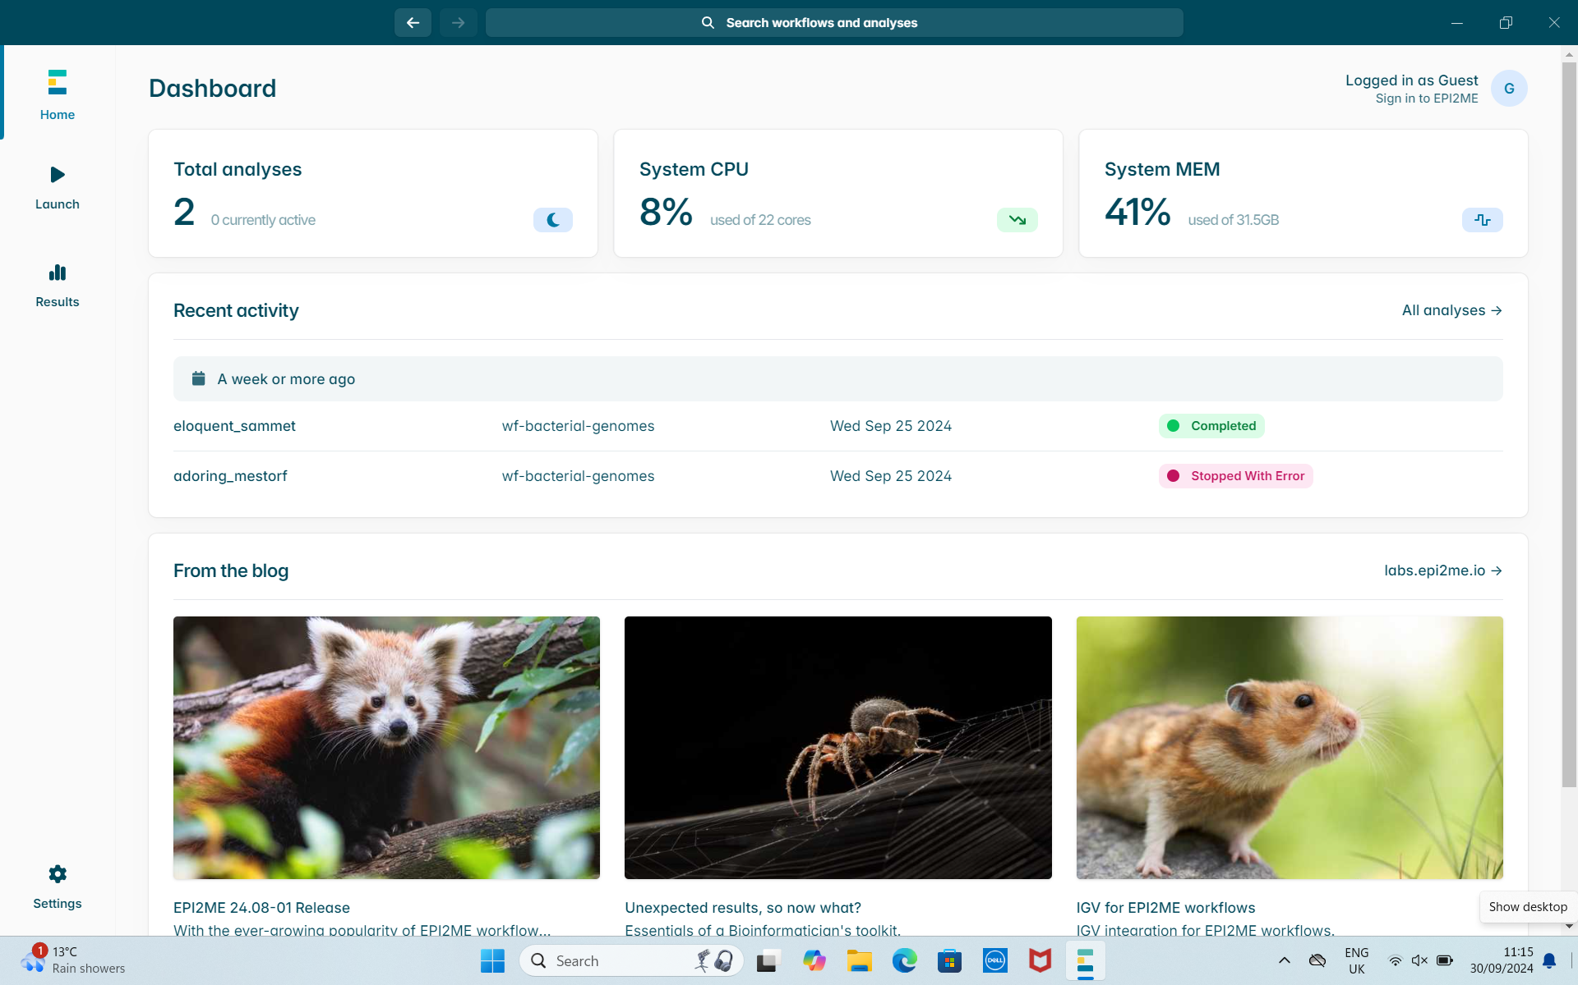
EPI2ME

Slide 17
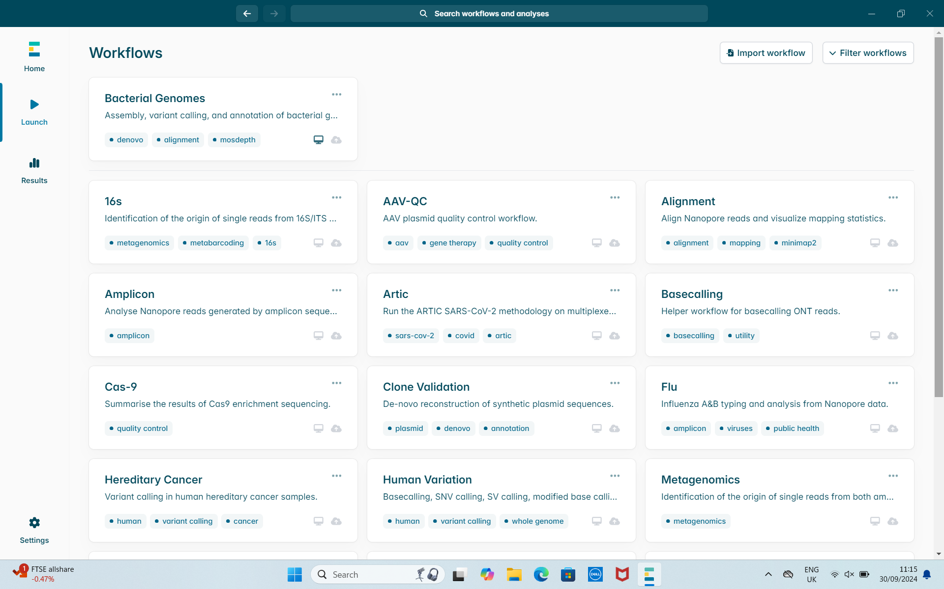
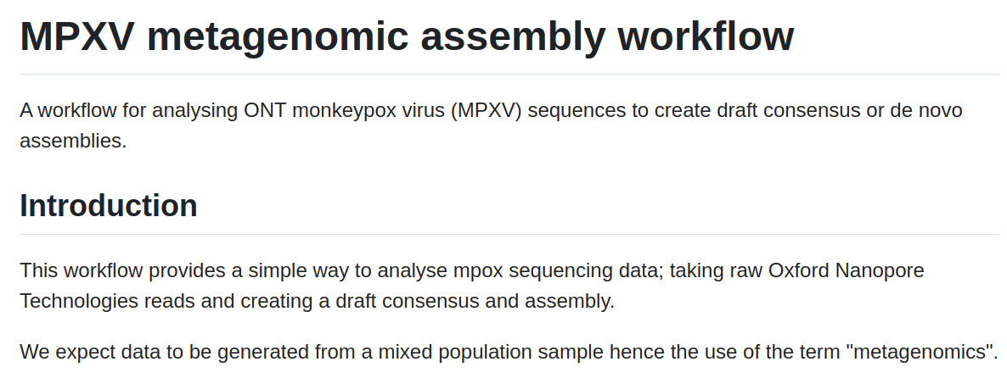
EPI2ME - Nanopore workflows

Slide 18
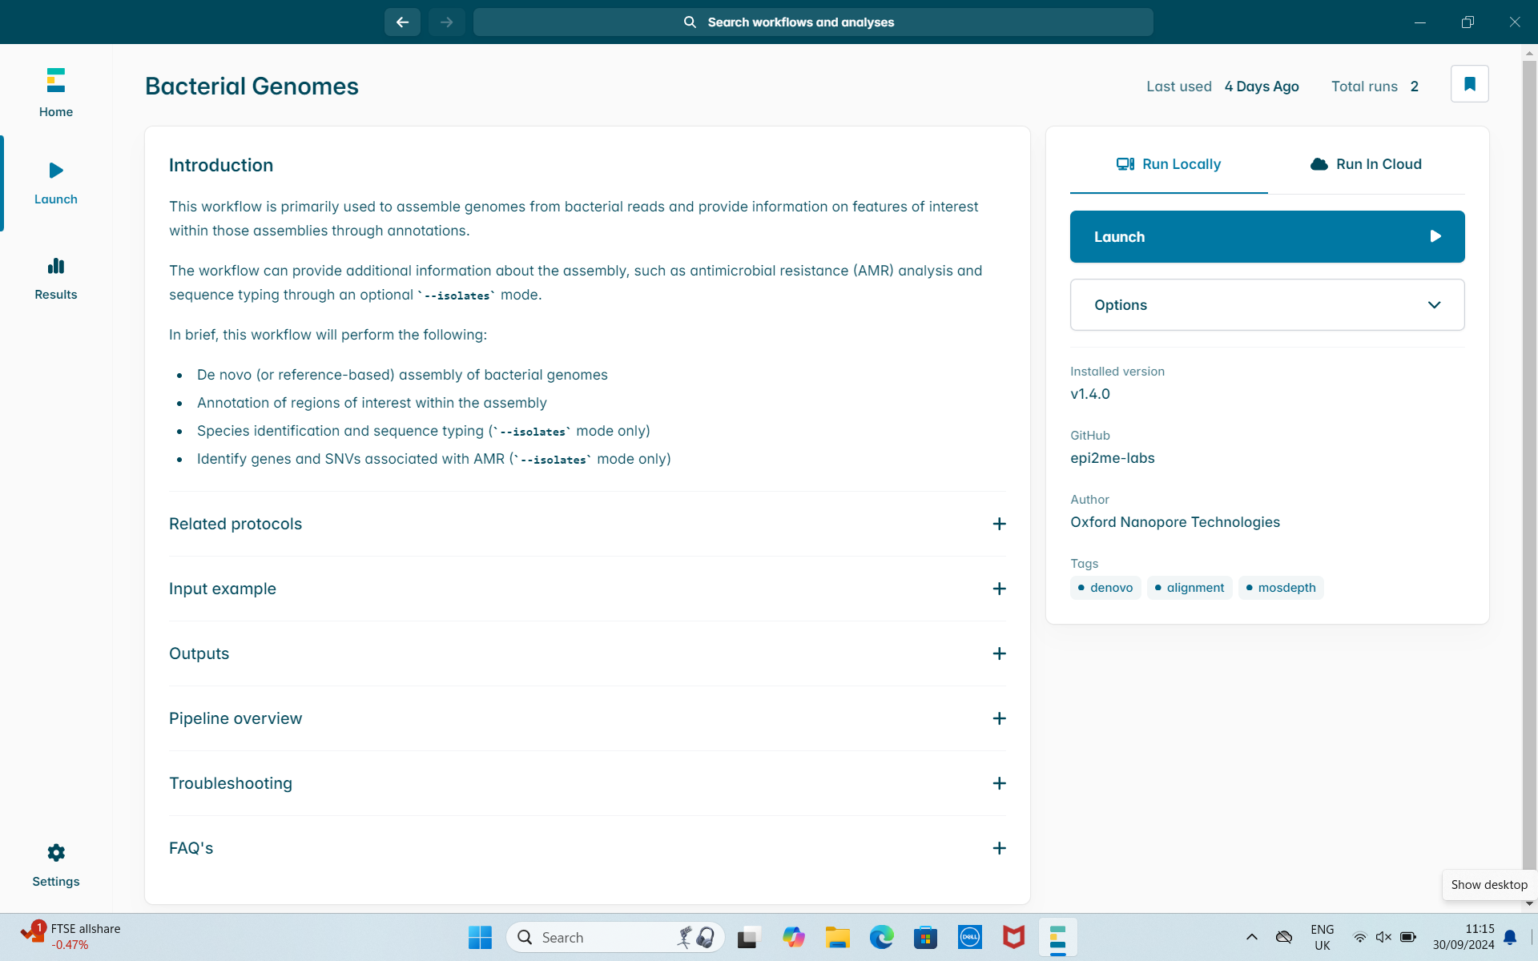
EPI2ME - Bacterial Genomes

Slide 19
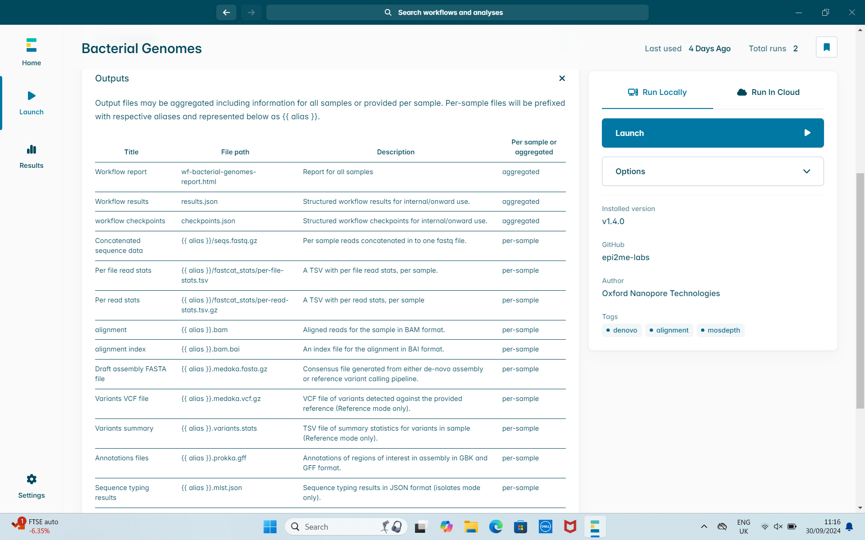
EPI2ME - Bacterial Genomes

Slide 20
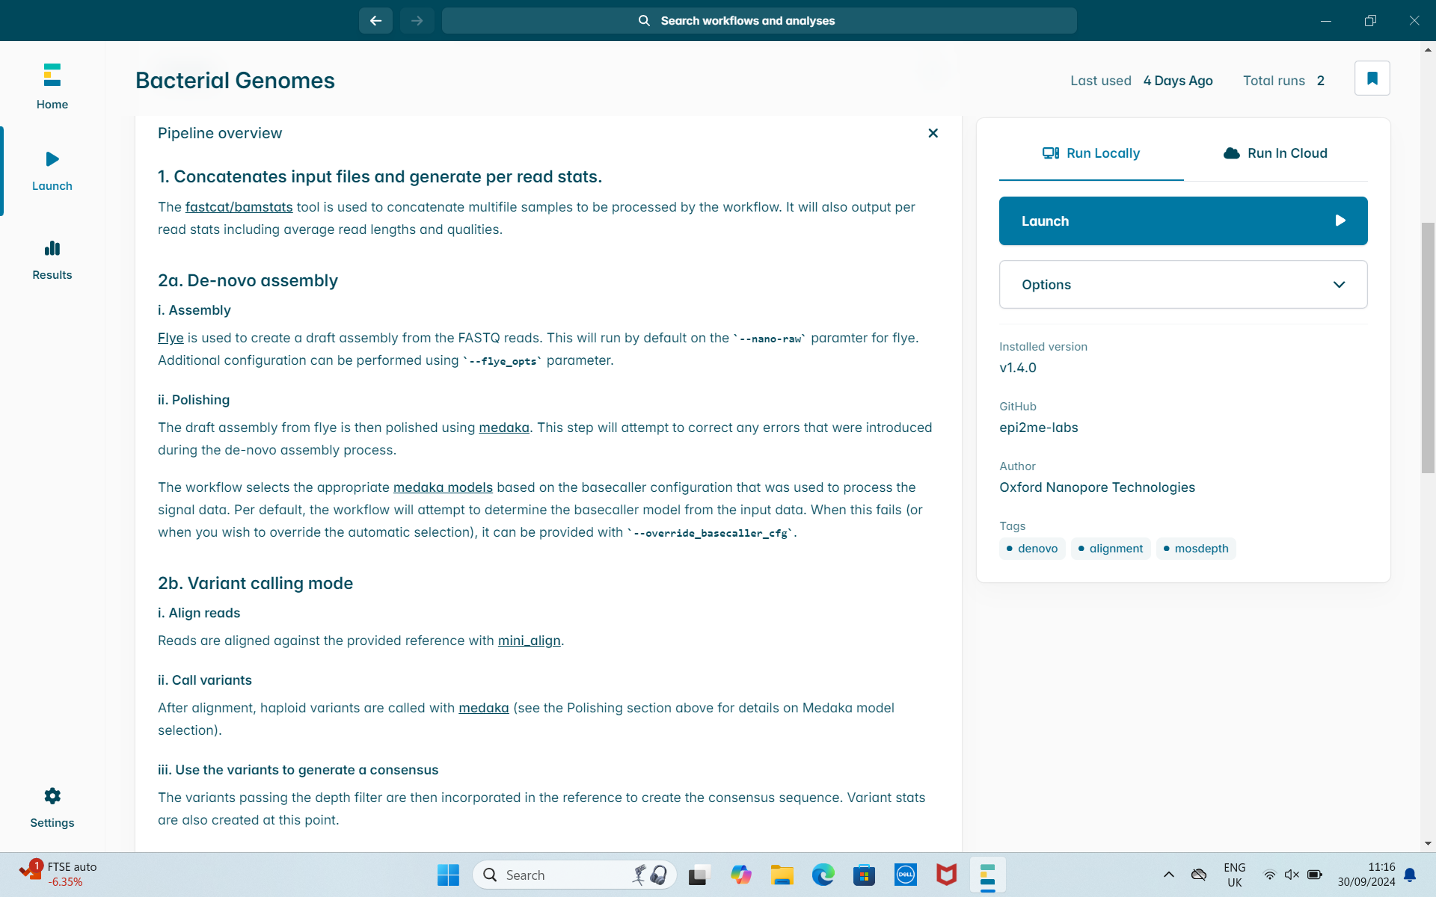
EPI2ME - Bacterial Genomes

Slide 21
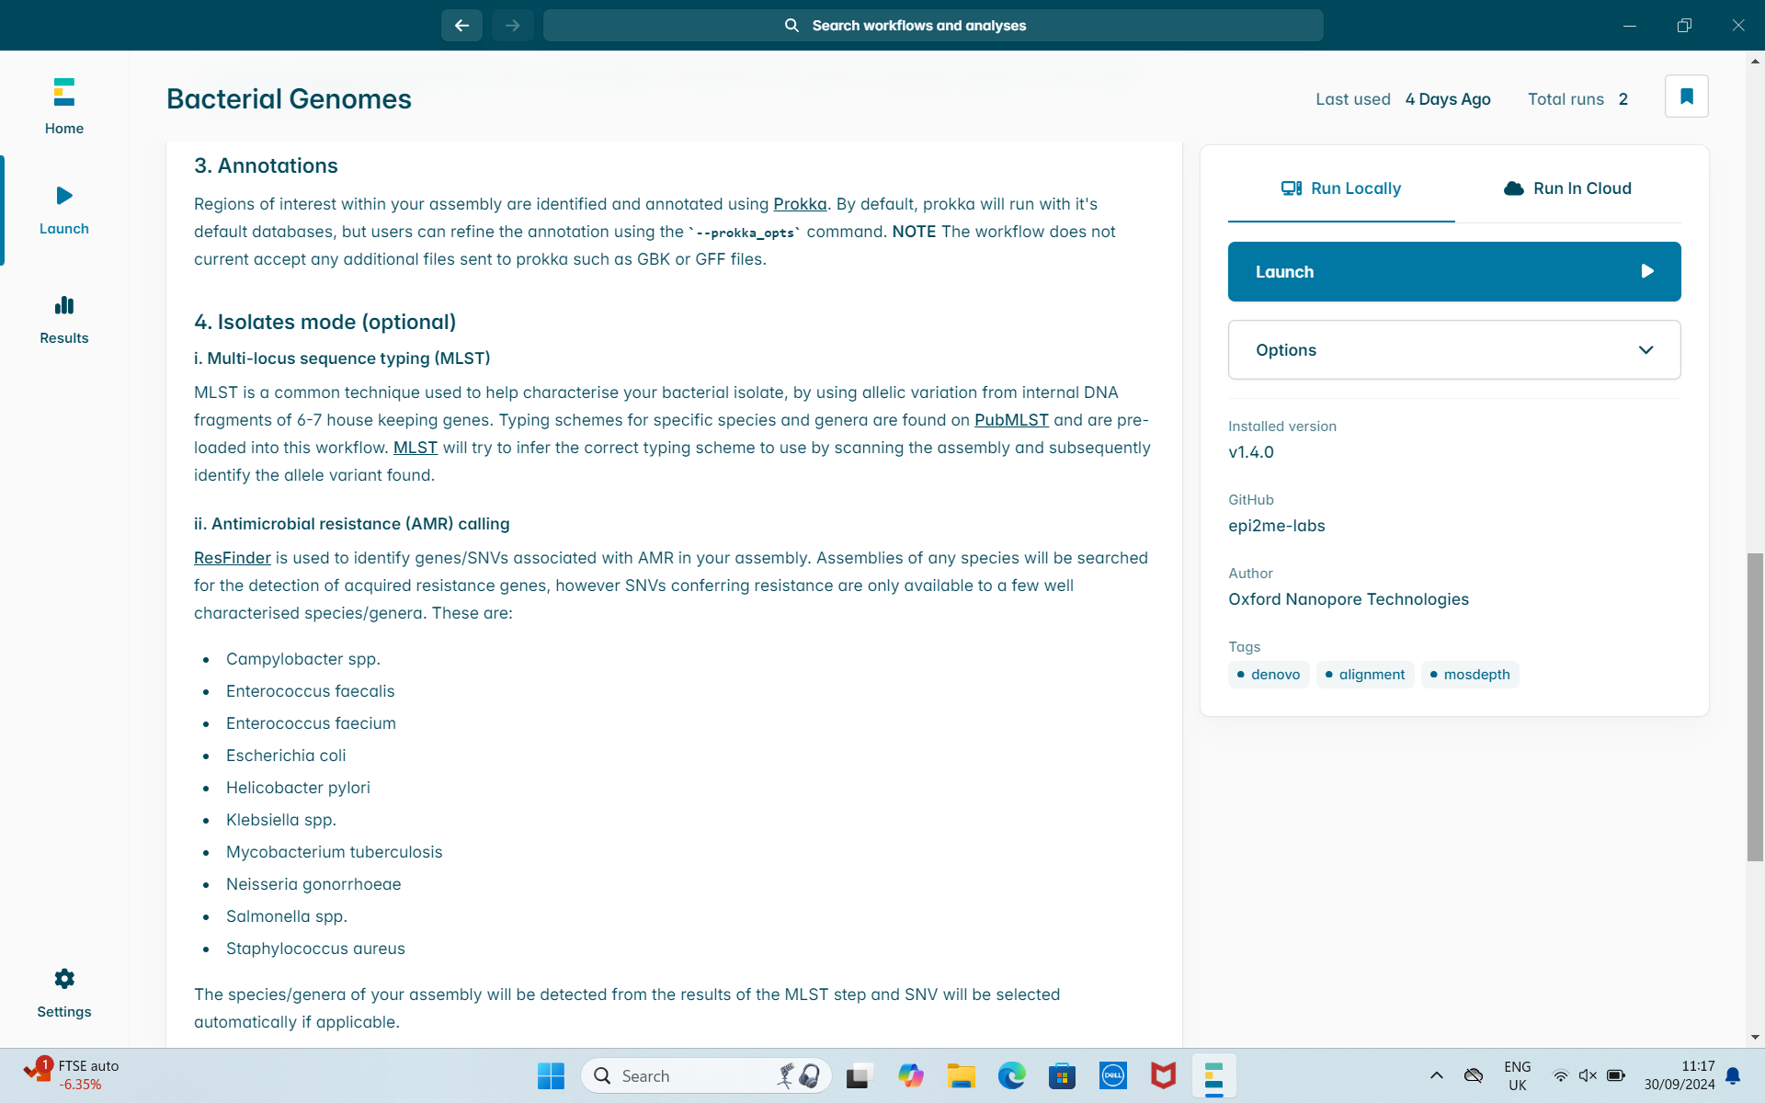
EPI2ME - Bacterial Genomes

Slide 22
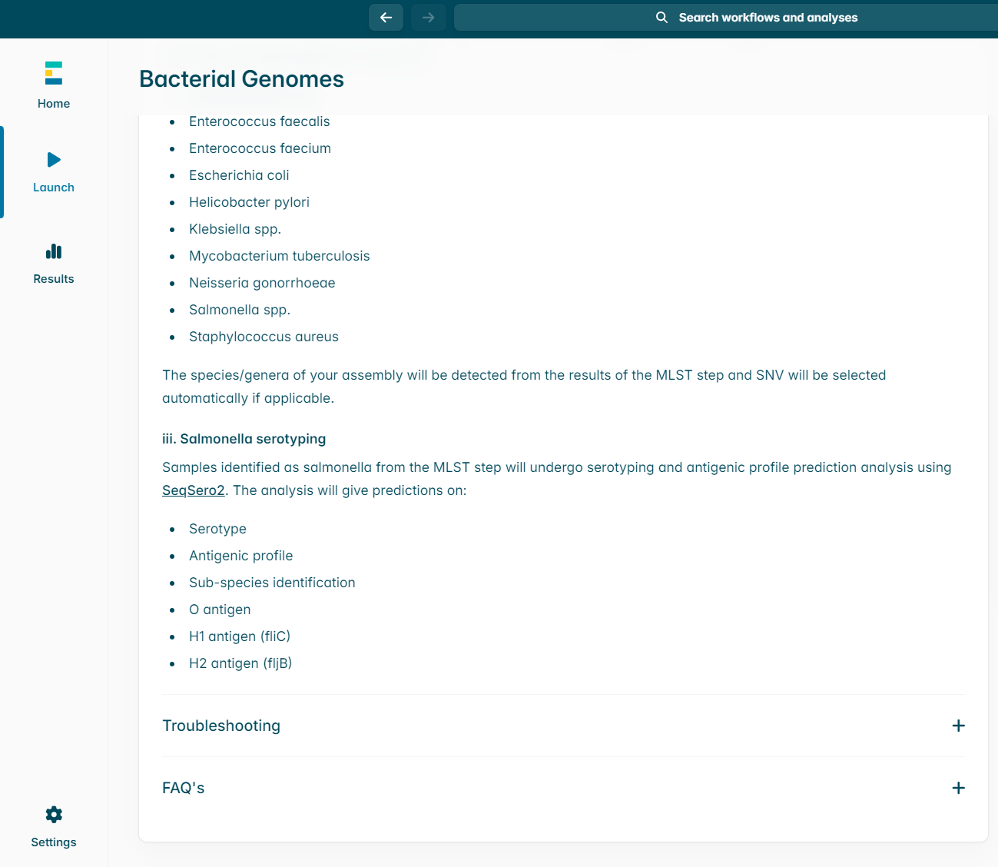
EPI2ME - Bacterial Genomes

Slide 23
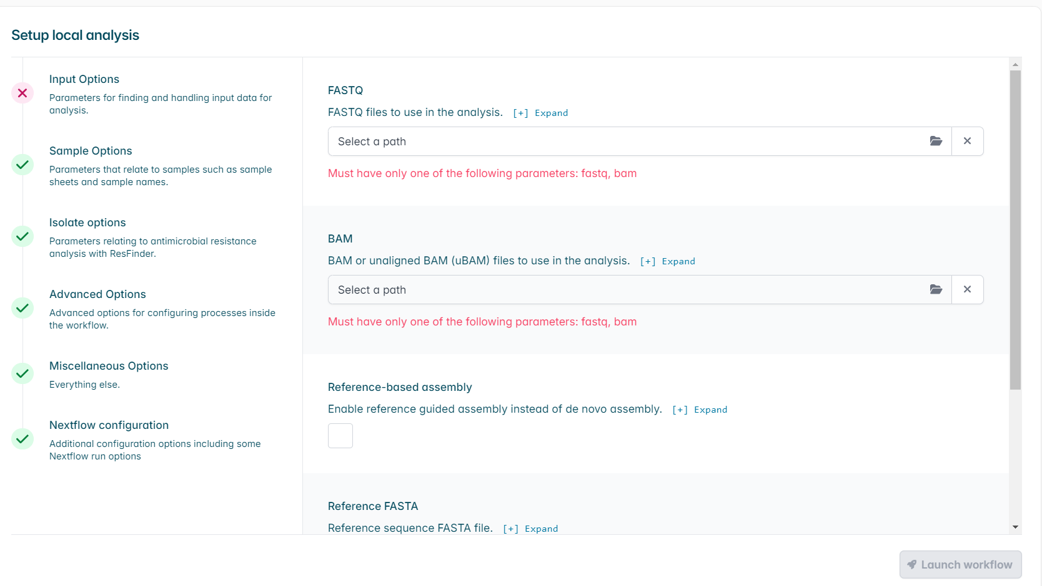
EPI2ME - Input Options
Input reads
FASTQ
Folder where all FASTQs stored

Slide 24
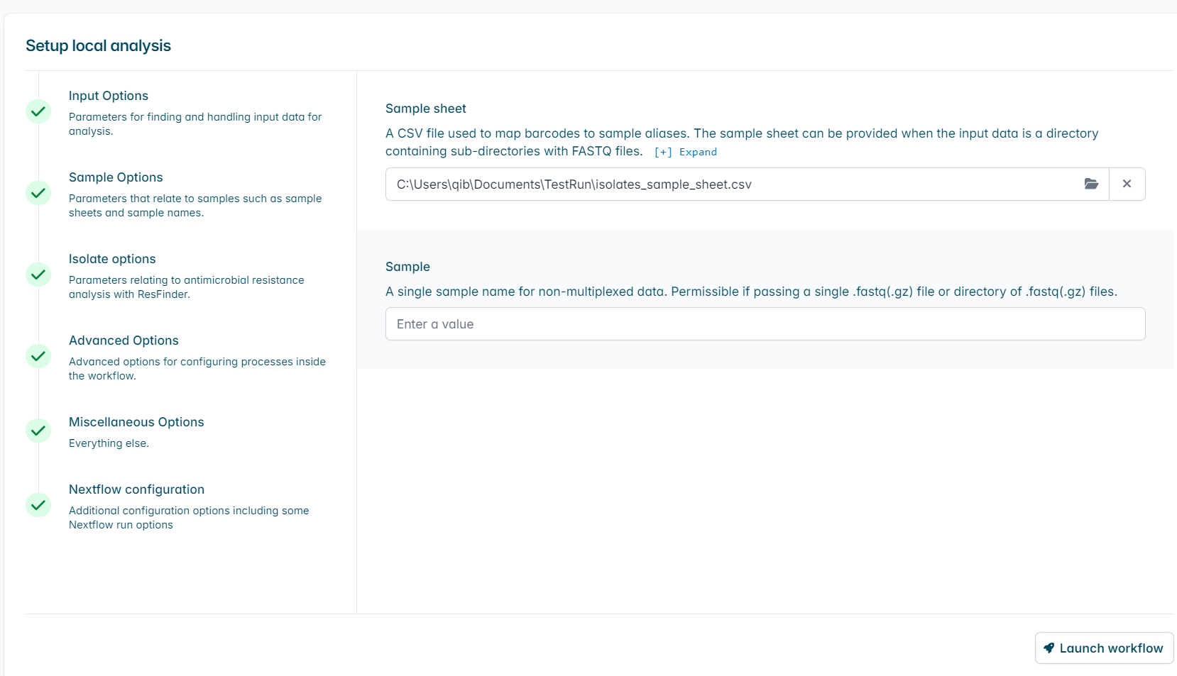
EPI2ME - Sample Options
Sample sheet
Comma separated file
barcode,alias
barcode01,test1
barcode02,test2

Slide 25
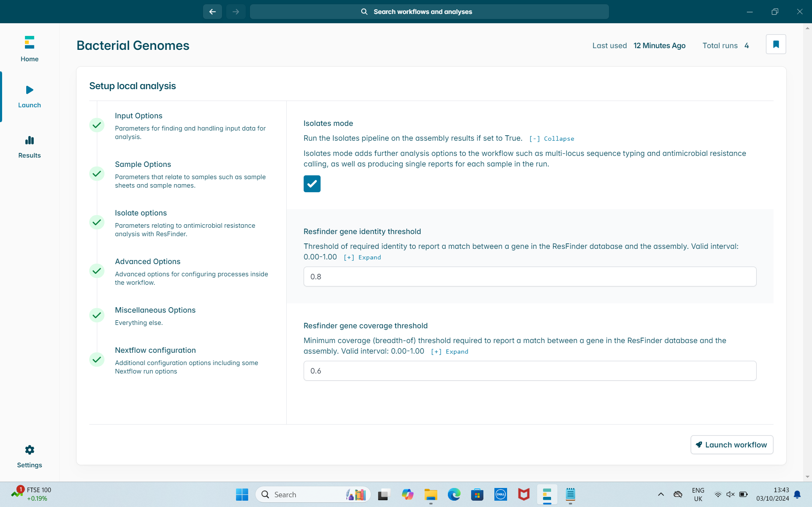
EPI2ME - Isolate Options
Isolates mode
MLST and AMR
This affects the length of time it runs

Slide 26
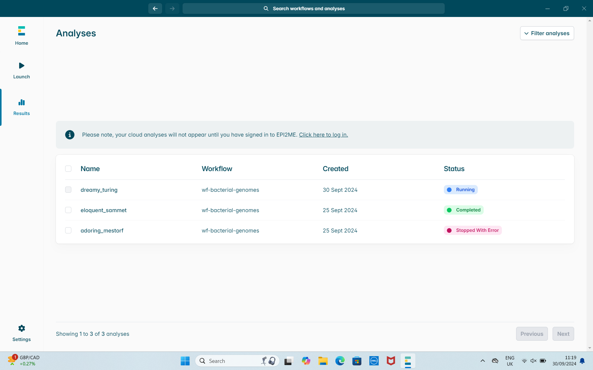
EPI2ME - Tracking the results

Slide 27
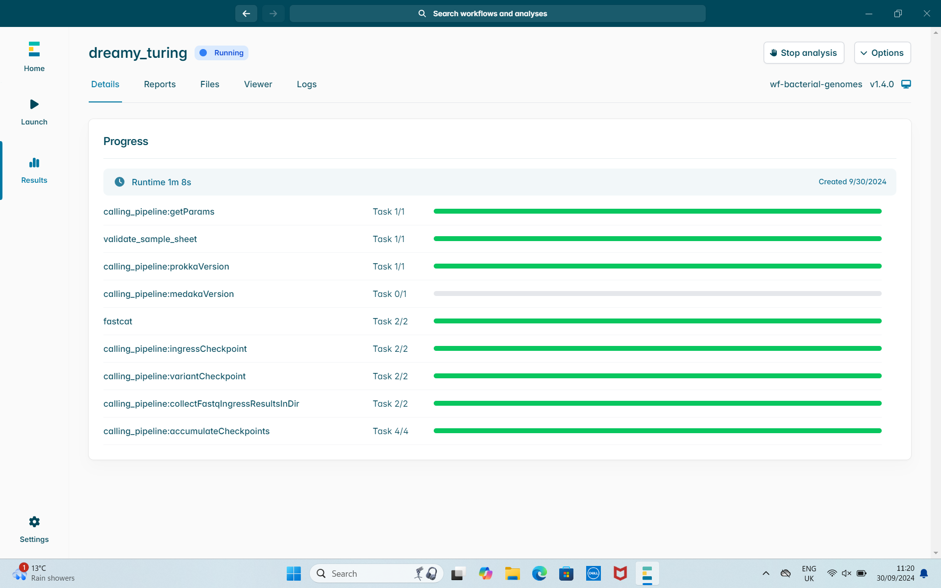
EPI2ME - Tracking the results
Automatically creates all the tasks for you
Pending
Running
Complete
Failed

Slide 28
EPI2ME - Tracking the results
What if the run stops ?
Resumes from the last point
Pending
Running
Complete
Failed

Slide 29
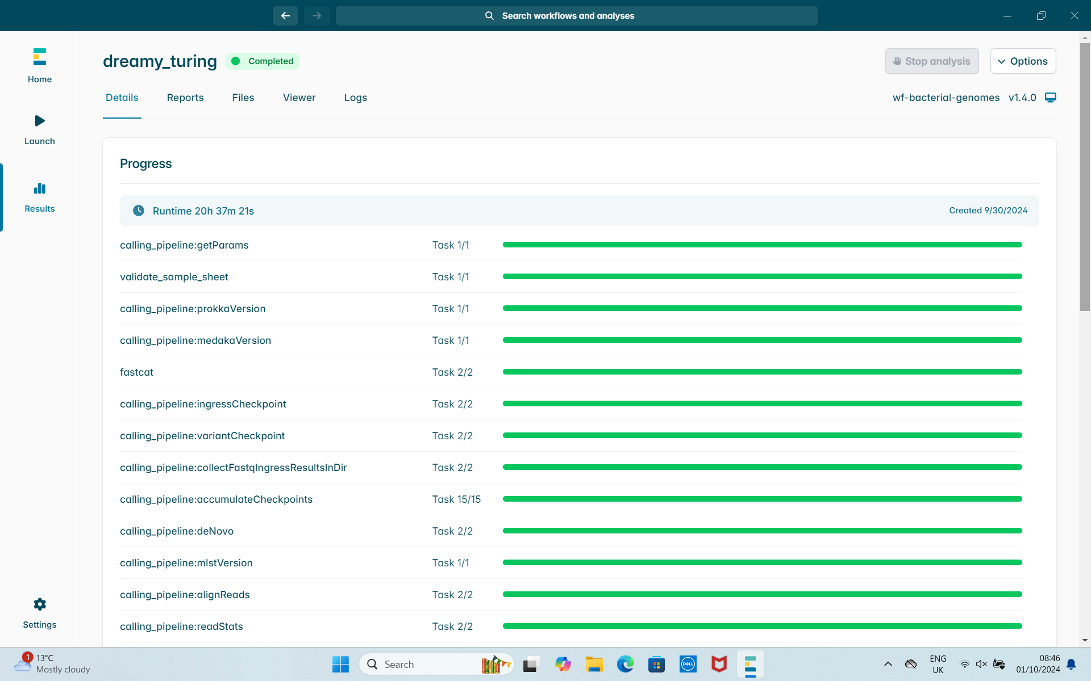
EPI2ME - Tracking the results
Why so long?
The first time you run the workflow, databases will be downloaded
Second run:
~30 minutes

Slide 30
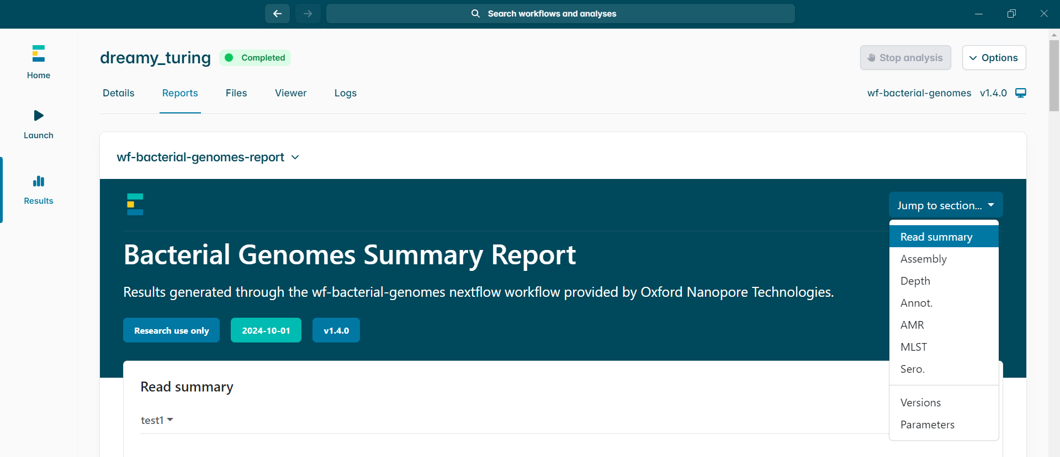
EPI2ME - Report Summary

Slide 31
Read Quality
To find out if your sequences are good quality there are few different aspects to check:
Read quality, length and yield, trim adapters
Short read: FASTQC, trim and filter (Cutadapt/TrimGalore!)
Long read: filtlong, porechop, Nanoplot, Nanostat

Slide 32
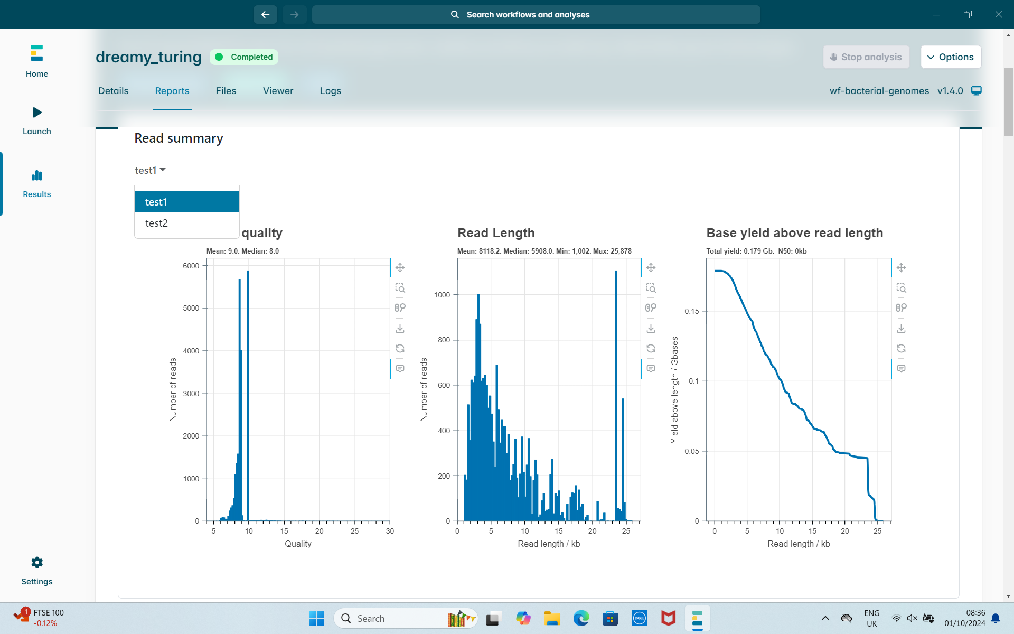
EPI2ME - Read Summary

Slide 33
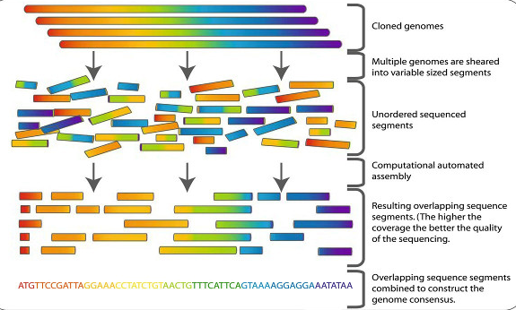
Genome Assembly
fragments
contigs

Slide 34
Genome Assembly
To assemble your genomes, different software can be used depending on your sequence types:
Short read: Shovill (SPAdes) - https://github.com/tseemann/shovill
Long read: Flye - https://github.com/mikolmogorov/Flye
Hybrid: Unicycler - https://github.com/rrwick/Unicycler

Slide 35
Genome Assembly quality
To find out if your Assemblies (FASTA) are good quality there are few different aspects you can check:
No. Contigs, N50, No. Reads, quality, No. Genes - (QUAST)
GC content - expected for isolate e.g Typhi ~52% ? (fastp)
Coverage e.g 10X, 20X (fastp, samtools)
Compare to a reference genome (BUSCO, CheckM)
Contamination (Kraken and Bracken)

Slide 36
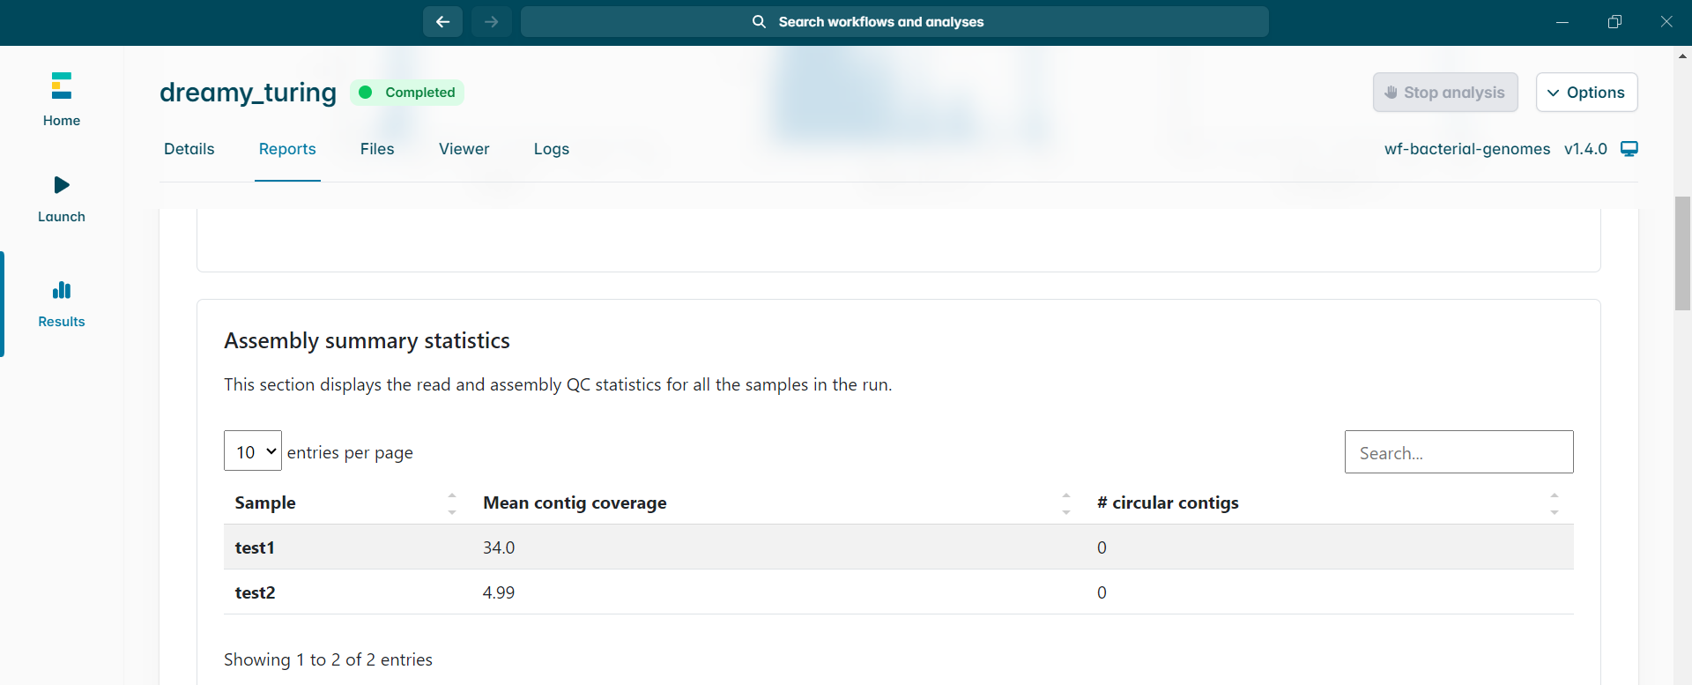
EPI2ME - Assembly Summary

Slide 37
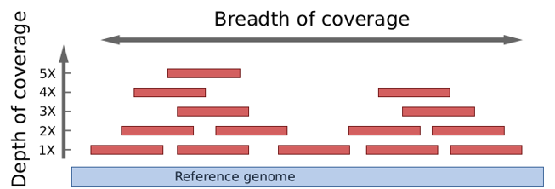
EPI2ME - Genome coverage
Different coverage can tell you more/less information
The average Salmonella genome is ~5.1Mb in size
10X=~51Mb, 20X=~102Mb and 30X=~153Mb

Slide 38
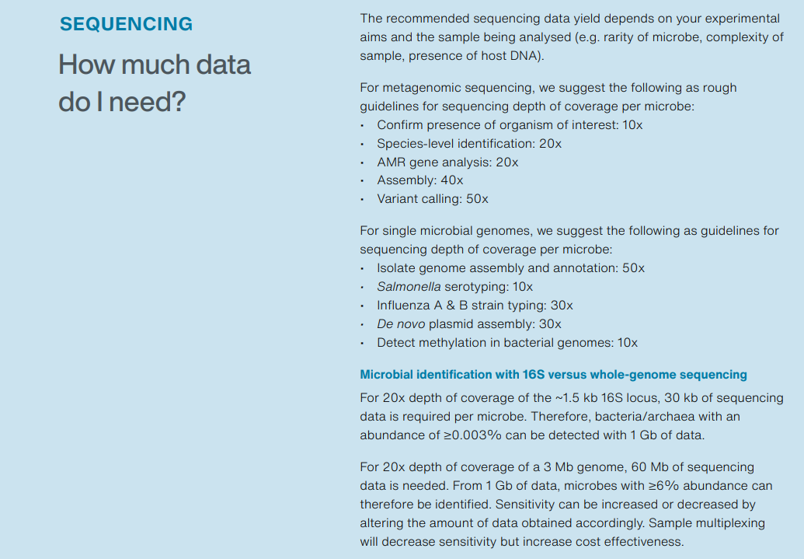
EPI2ME - Genome coverage

Slide 39
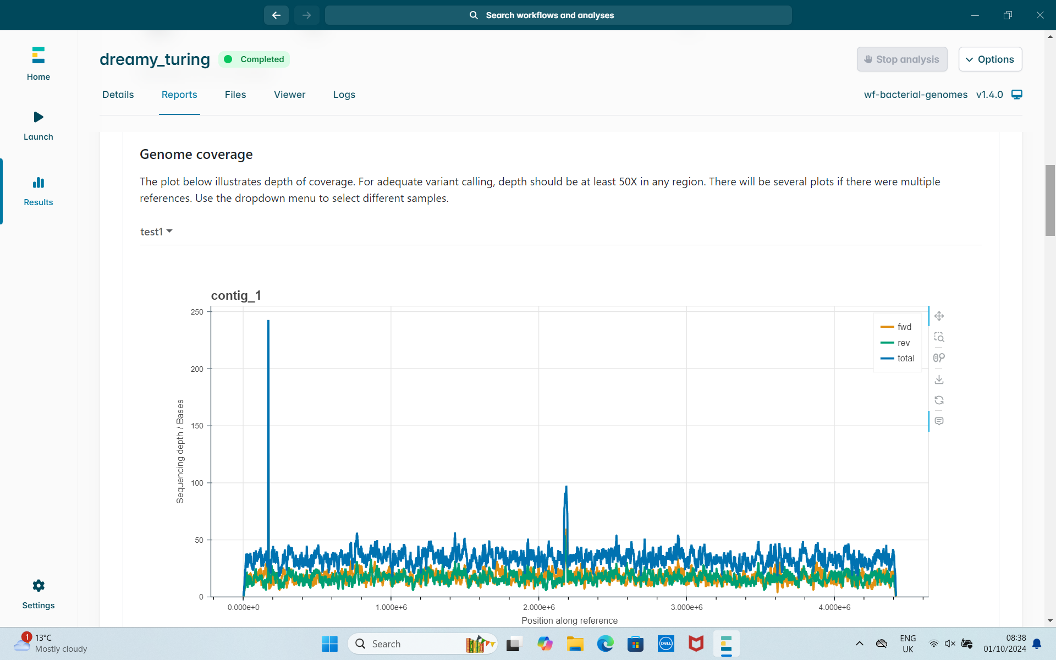
EPI2ME - Genome coverage

Slide 40
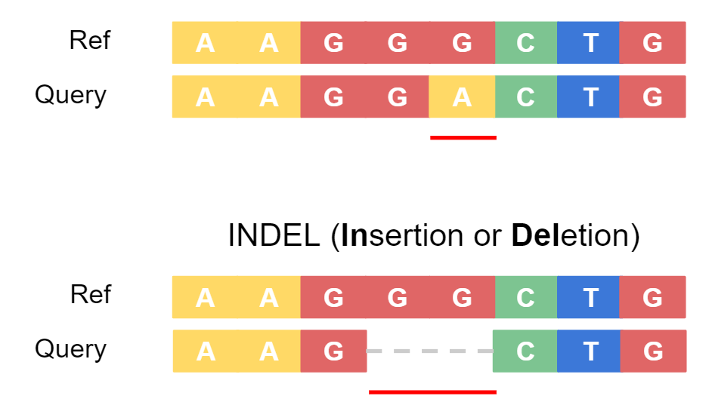
Variant calling
Looking at variations in sequences of an isolate or population
SNP (Single Nucleotide Polymorphism) vs SNV (Single Nucleotide Variant)
SNPs are in at least 1% population while SNVs in single isolate
snippy (SNPs) - https://github.com/tseemann/snippy ​
Medaka (SNVs) - https://github.com/nanoporetech/medaka

Slide 41
Genome Annotation
Identify features present in your genome assembly and provide extra information (GFF/GBK)
Uses different databases to identify features e.g NCBI
Prokka - https://github.com/tseemann/prokka
Bakta - https://github.com/oschwengers/bakta
Gene 1
ttr

Slide 42
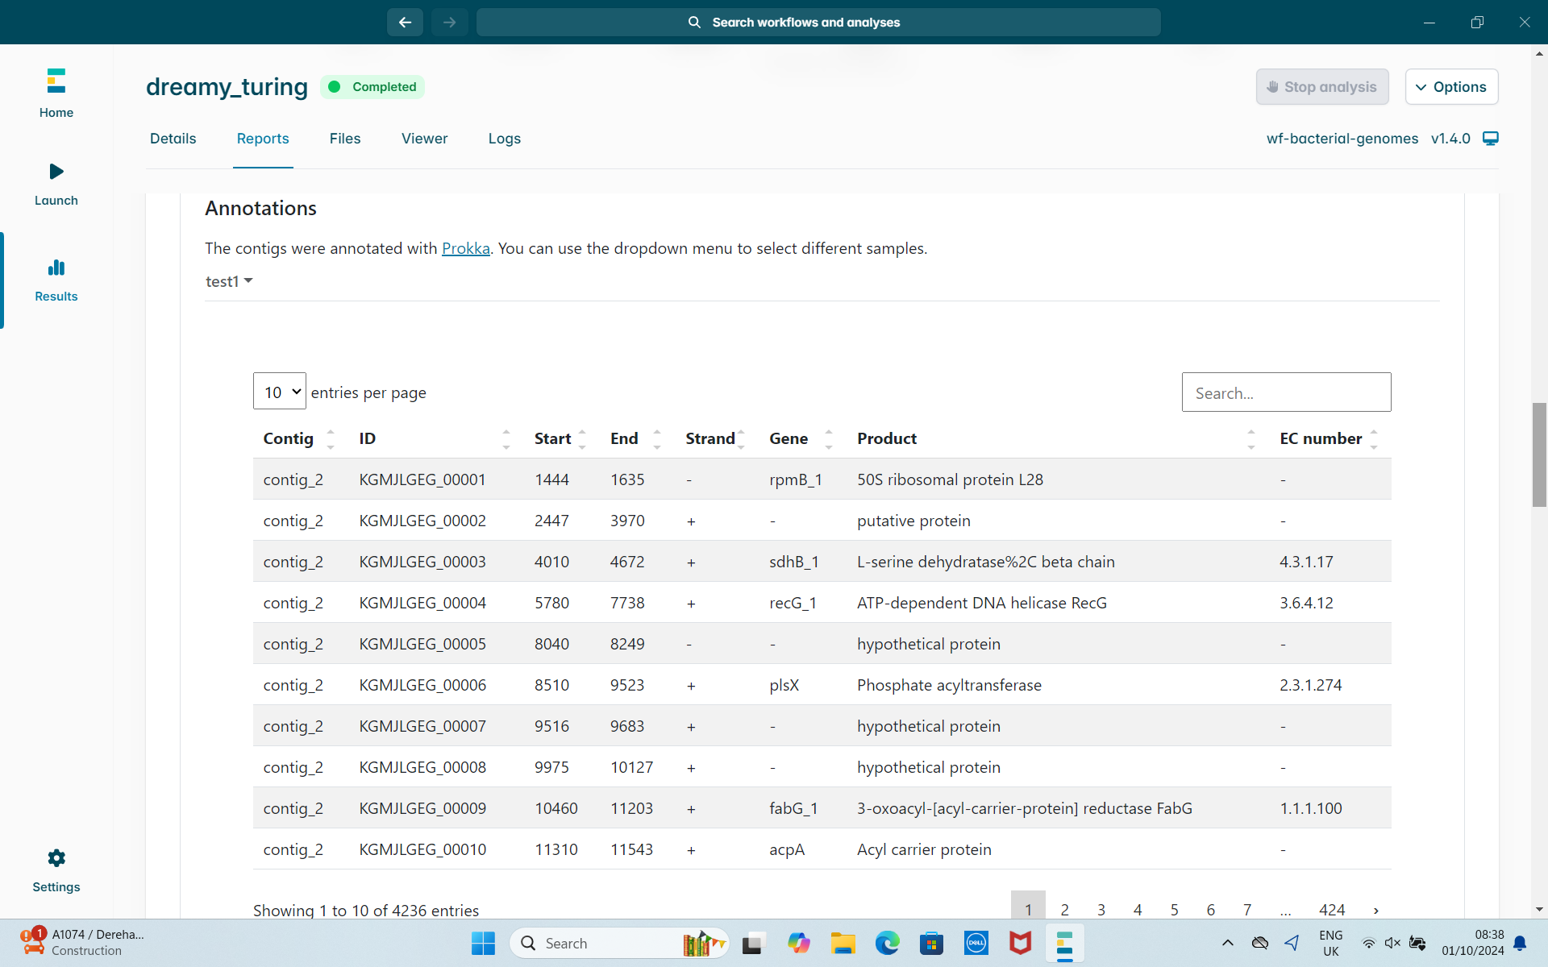
EPI2ME - Annotations

Slide 43
Antimicrobial resistance (AMR) calling
Use databases to identify AMR genes:
ResFinder - http://genepi.food.dtu.dk/resfinder
PointFinder - https://github.com/stanikae/jekesa/blob/master/bin/PointFinder.py
staramr - https://github.com/phac-nml/staramr
ABRicate - https://github.com/tseemann/abricate

Slide 44
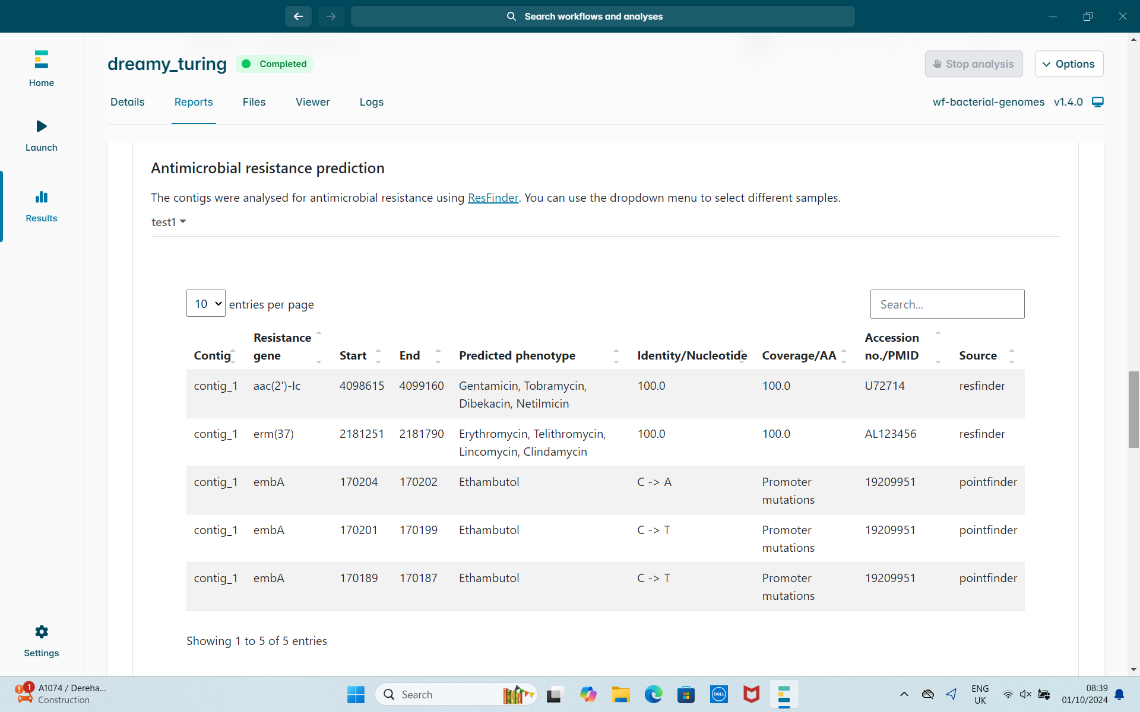
EPI2ME - ResFinder output
Resfinder – Whole genes
Pointfinder – Point mutation specific

Slide 45
Multi-locus sequence typing (MLST)
Identify groups of similar bacteria using typing schemes
Salmonella – 7 genes (aroC, dnaN, hemD, hisD, purE, sucA, and thrA)
mlst - https://github.com/tseemann/mlst
Online tool - https://pubmlst.org/bigsdb?db=pubmlst_salmonella_seqdef
Schemes - https://pubmlst.org/organisms
Species
Serotype
Sequence Type
Subspecies
SNPs

Slide 46
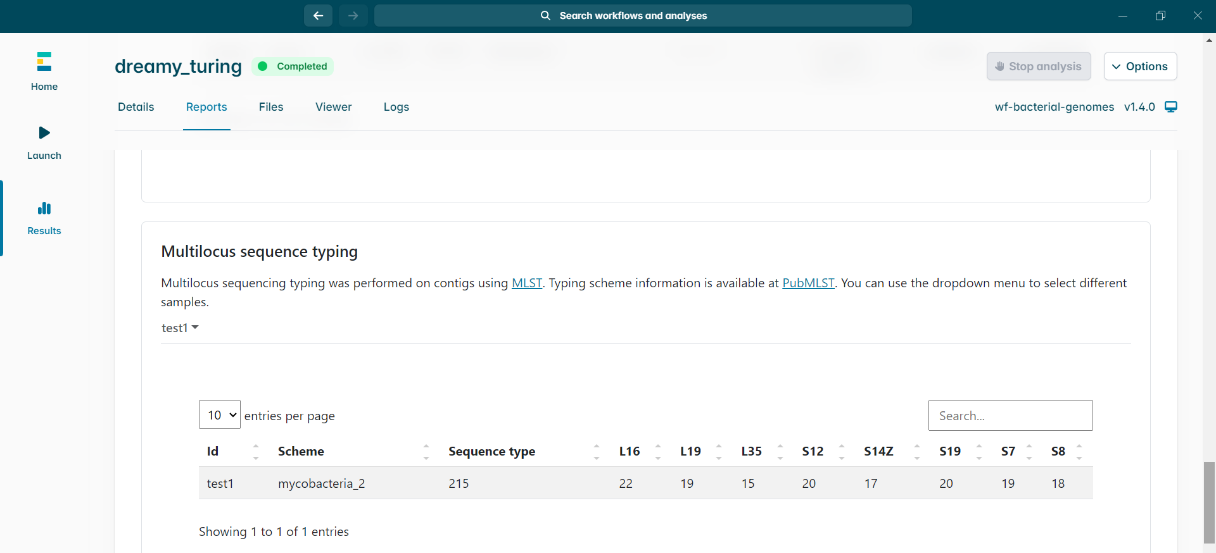
EPI2ME - MLST output

Slide 47
SeqSero2
Predict Salmonella serotype of your isolates
Traditionally phenotypic method (agglutination)
>2600 serotypes
O (somatic) and H (flagellar) antigens
Online tool:
http://www.denglab.info/SeqSero2
GitHub: https://github.com/denglab/SeqSero2
Type | Somatic (O) antigen | Flagellar (H) antigen Phase I | Flagellar (H) antigen Phase II | Other
Typhi | 9,12[Vi] | d | - | [z₆₆]

Slide 48
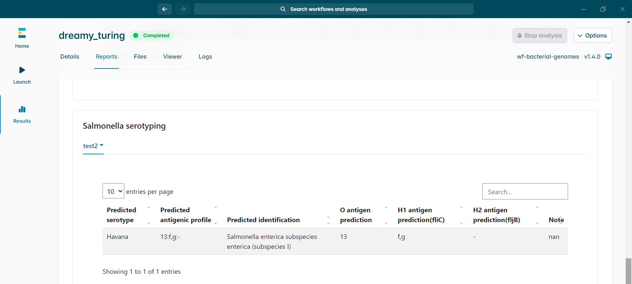
EPI2ME - SeqSero output

Slide 49
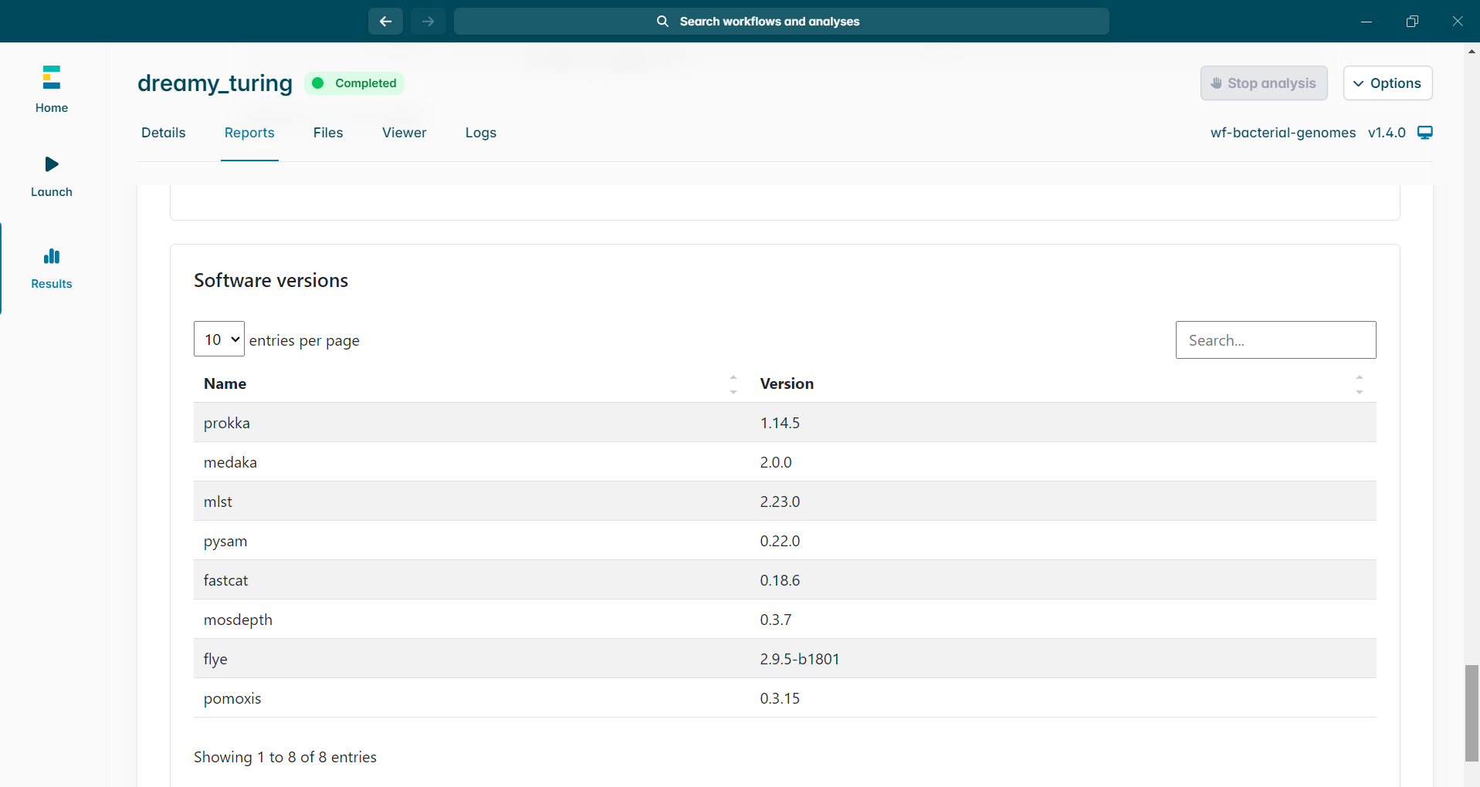
EPI2ME - Software versions
Important for reproducing work and manuscripts

Slide 50
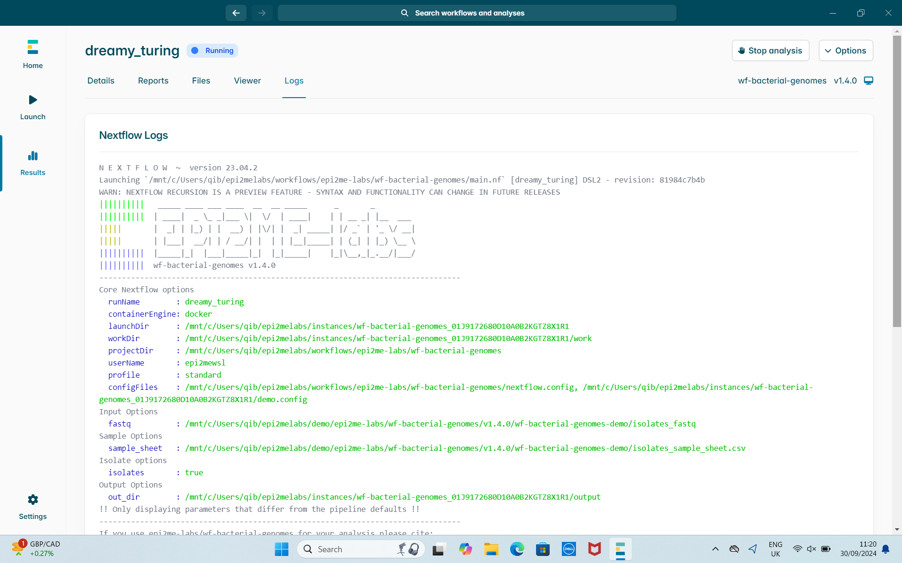
EPI2ME - Nextflow logs
Important for tracking inputs/outputs and errors

Slide 51
FAQs
https://labs.epi2me.io/faq/
The workflow I ran ended with an error, what steps should I take next? Which files are needed to send in with a support ticket?
Try to rerun the workflow, it will try to complete from where it failed. If the workflow fails again please contact us [EPI2ME]

Slide 52
Other analysis tools

Slide 53

Galaxy
https://galaxyproject.org/
Web based platform to perform Bioinformatic analysis
Login required
Lots of tutorials available
Not all software is available by default
Training:
https://training.galaxyproject.org/

Slide 54
Galaxy
https://galaxyproject.org/
Accessibility - no programming experience needed
Reproducibility - repeat bioinformatic analysis (track tools and versions)
Transparency - share/publish analysis
Lots of help on the forum: https://help.galaxyproject.org/

Slide 55
Galaxy
Intro to Galaxy:
https://training.galaxyproject.org/training-material/topics/introduction/tutorials/introduction/slides-plain.html
Register and verify your account
Using Galaxy
Long read Tutorial
Intro to long read analysis:
https://training.galaxyproject.org/training-material/topics/assembly/tutorials/mrsa-nanopore/tutorial.html
Use Galaxy:
https://usegalaxy.org/

Slide 56
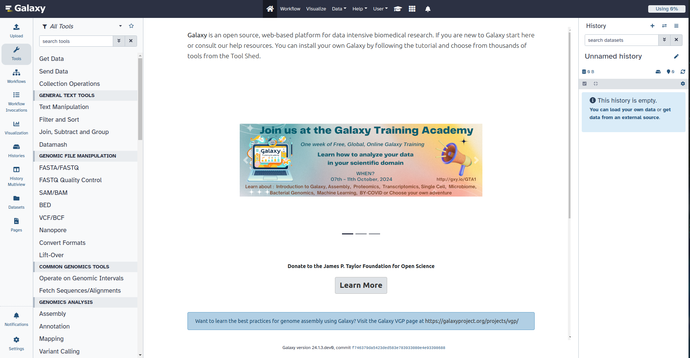
Galaxy Interface
Workspace
Tools
History
and Tool information

Slide 57
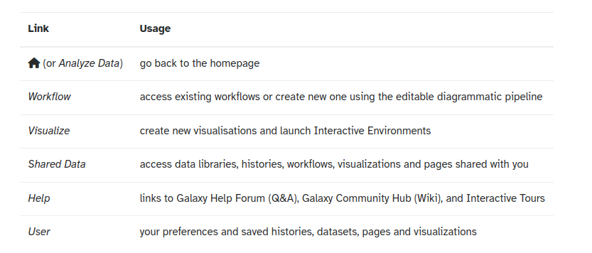
Galaxy Interface

Slide 58
Galaxy Interface - Tools
Search for some of the tools we've mentioned today e.g shovill, mlst
What information can you find ?
Tools can be used on their own or with others as part of a workflow

Slide 59
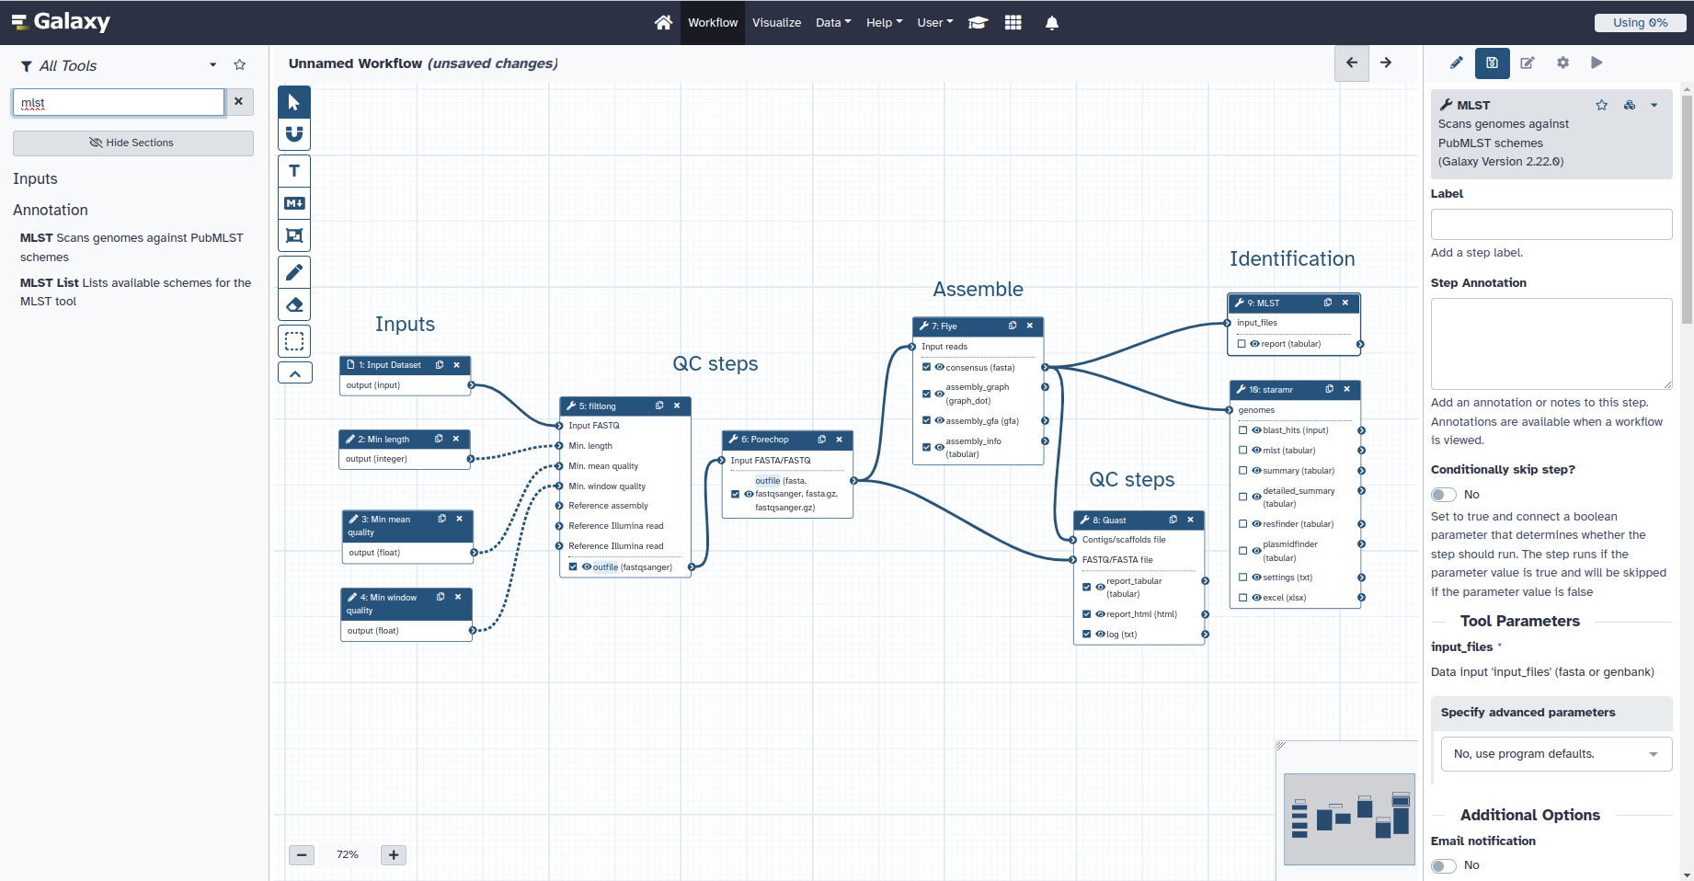
Galaxy workflows
Alter parameters
Tutorial Links
Citations
Add tools
Link them together

Slide 60
Galaxy Interface - History
Location of all analyses:
collects all datasets produced by tools
collects all operations performed on the data
For each dataset it tracks:
name, format, size, creation time, datatype-specific metadata
tool id, version, inputs, parameters
standard output (stdout) and error (stderr)
state (waiting, running, success, failed)
hidden, deleted, purged
Create a new history for each new analysis

Slide 61
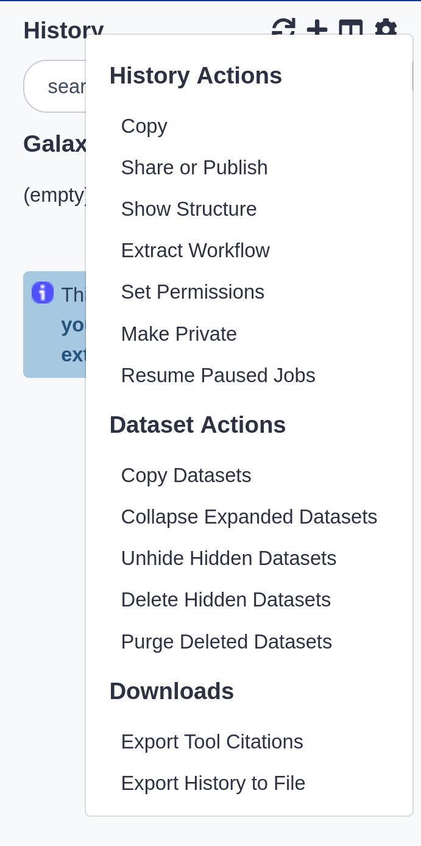
Galaxy Interface - History
History actions:
Resume Paused Jobs
Export Tool Citations

Slide 62
Downloading data
Manual download:
SRA - https://www.ncbi.nlm.nih.gov/Traces/study/
ENA - https://www.ebi.ac.uk/ena/browser/home
Zenodo - https://zenodo.org/
Command line - wget
fastq-dl - https://github.com/rpetit3/fastq-dl
Galaxy tools

Slide 63
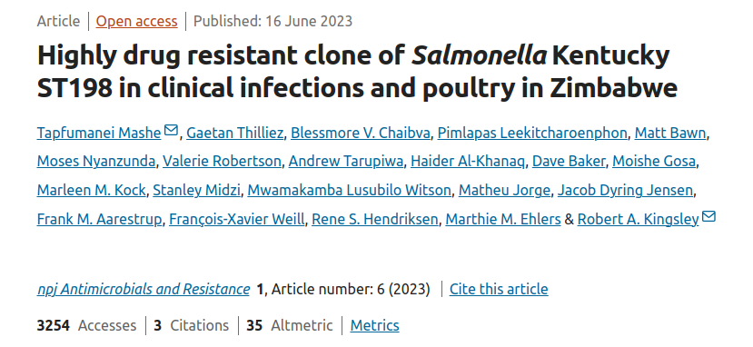
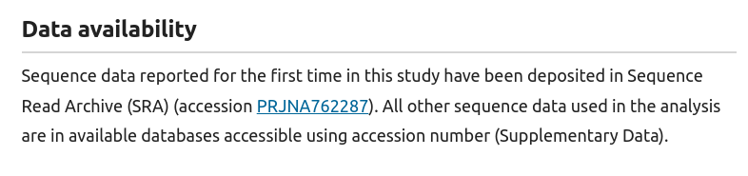
Downloading data - Short and Long reads
Salmonella Kentucky strains
Methods/Data availability
PRJNA762287

Slide 64
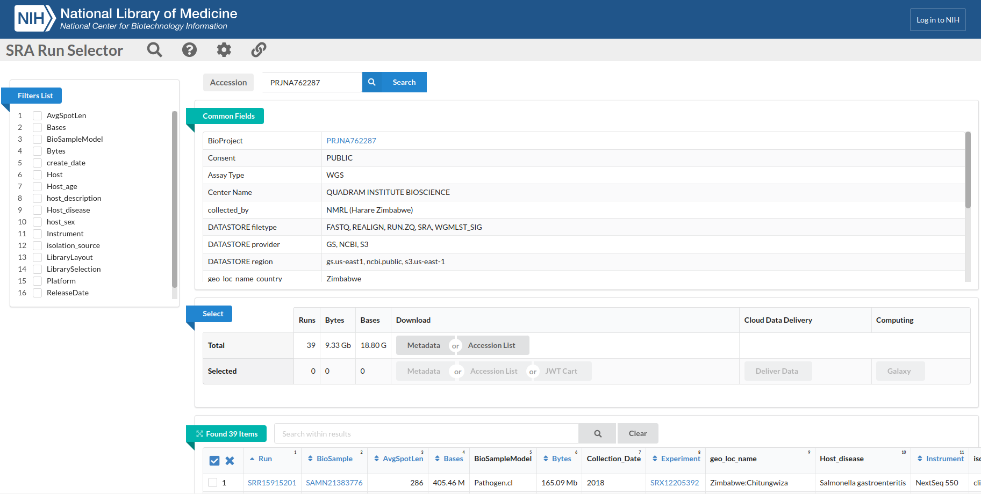
Downloading data - Short and Long reads

Slide 65
Downloading data - Short and Long reads
You can download either the metadata/sample accessions
To distinguish between short/long read look at Instrument/Platform
Or look at the Bases - long reads are far bigger (GB vs MB)
2 strains have both - NM17-19 and NM17-56

Slide 66
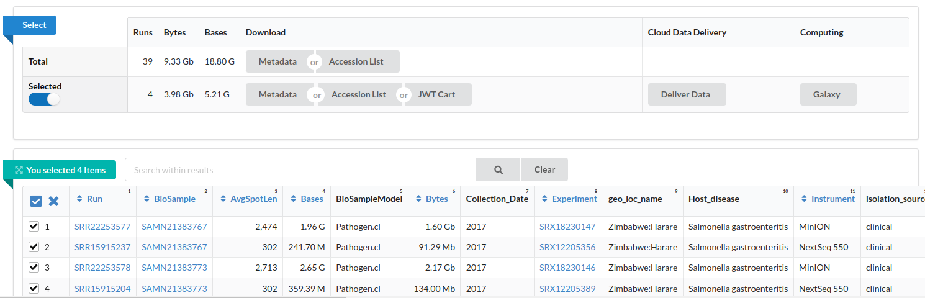
Downloading data - Short and Long reads
You can download either the metadata/sample accessions
To distinguish between short/long read look at Instrument/Platform

Slide 67
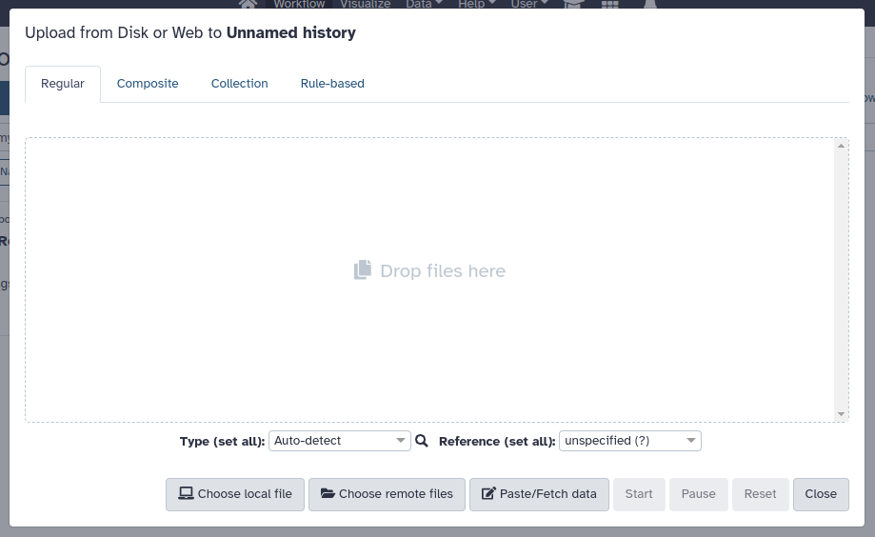
Galaxy - Uploading data
Regular - single
Collection - multiple files
Changes the format of the data in your History

Slide 68
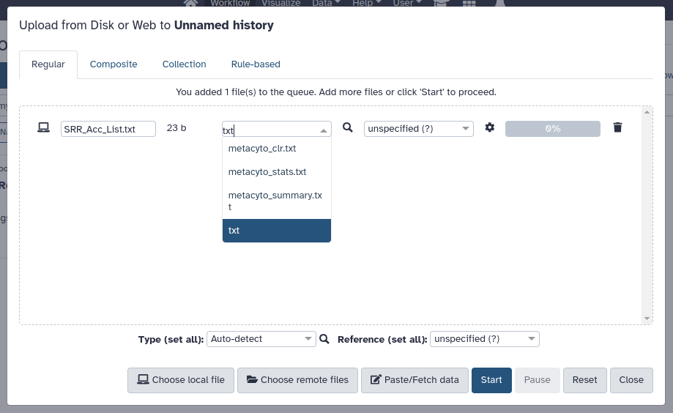
Galaxy - Uploading data
Upload SRR_Acc_List.txt
The file type can be estimated but isn't always right !
This will appear on the right

Slide 69
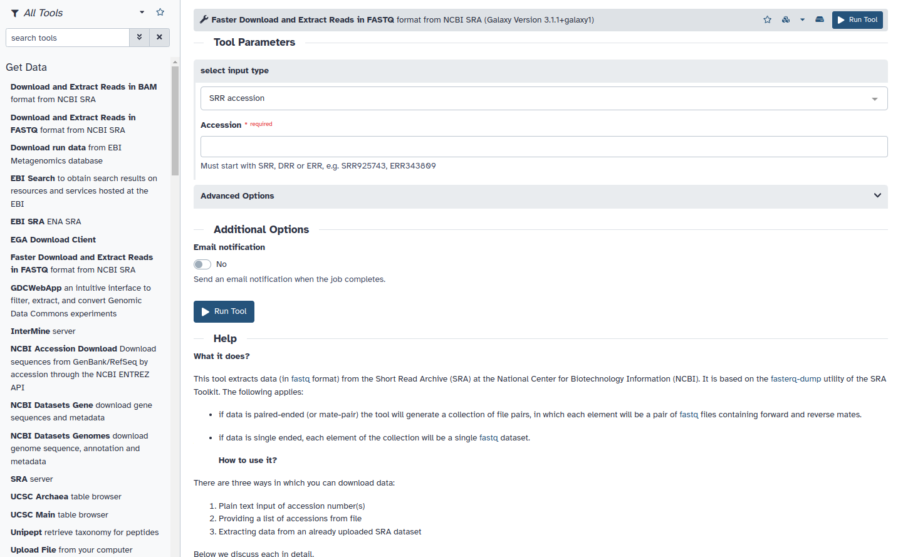
Galaxy - Uploading data
Select Faster Download tool

Slide 70
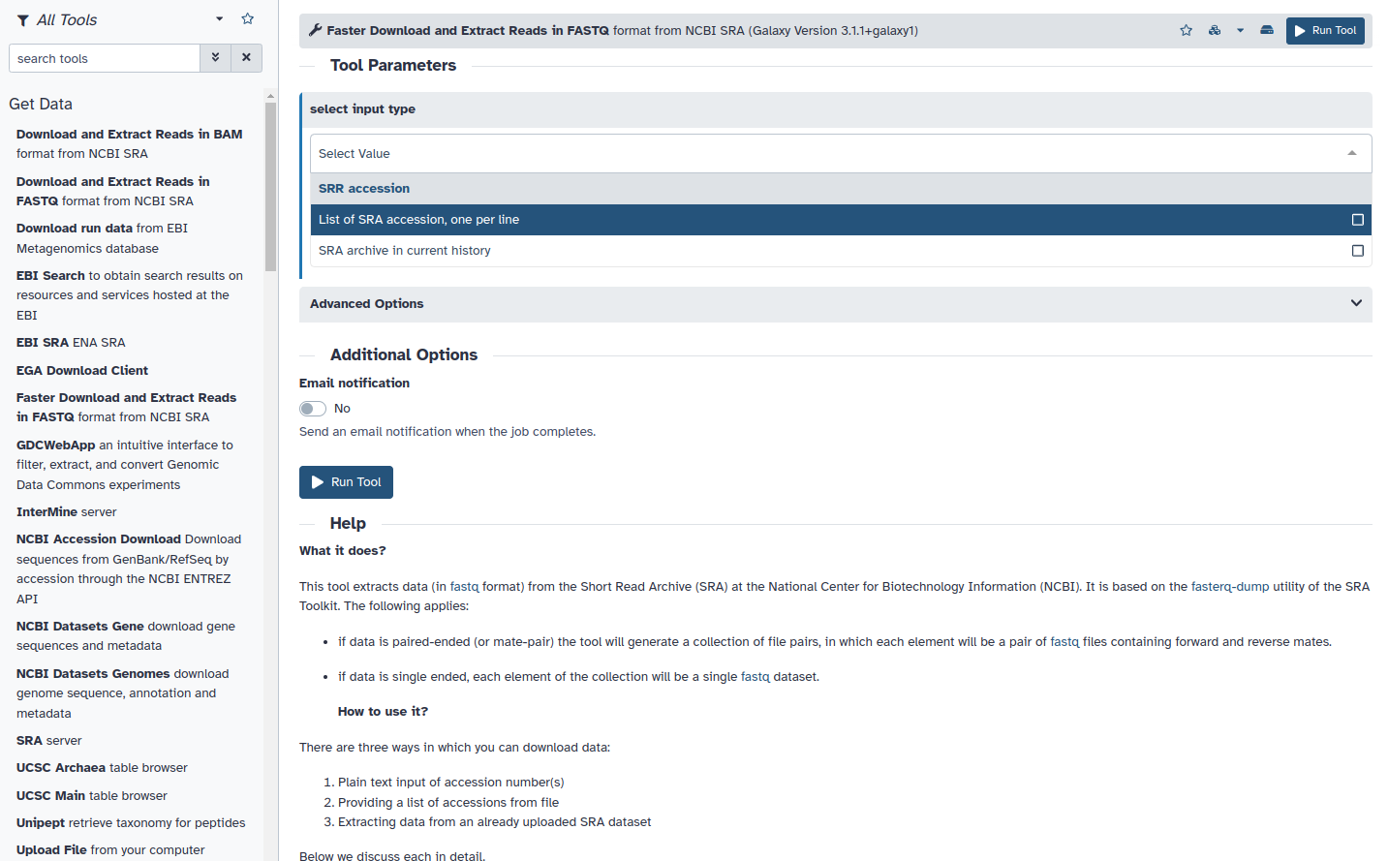
Galaxy - Uploading data
Different options for accessions:
SRR accession
List of SRA accessions
Select Faster Download tool

Slide 71
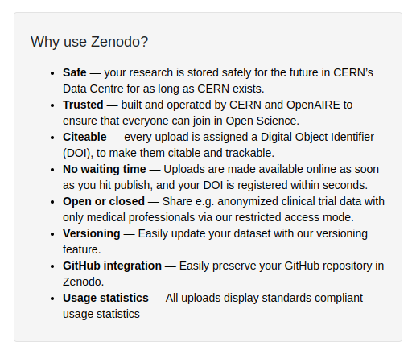
Downloading data - Zenodo
You can also download data from Zenodo – some GitHubs/papers will provide a link
Create a new history
Try switching between the two

Slide 72
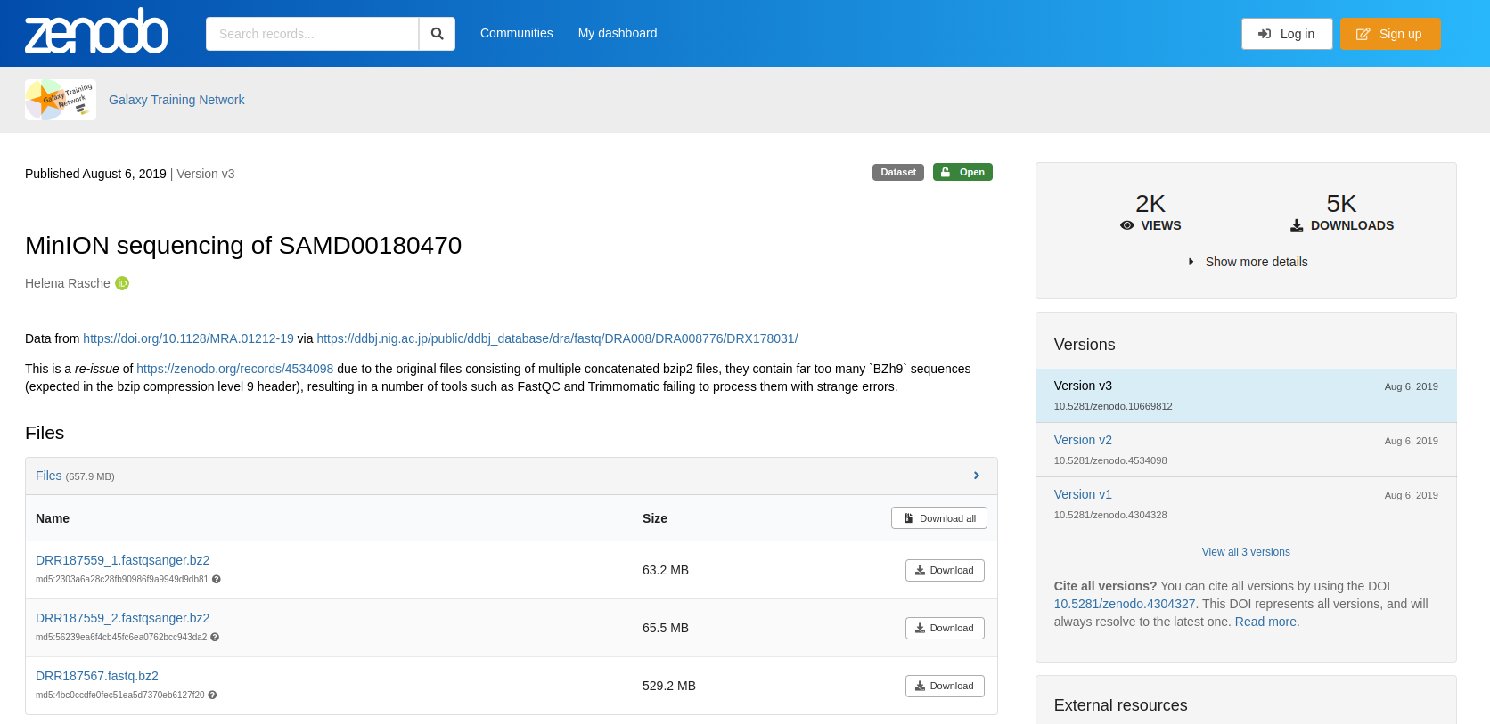
Downloading data - Zenodo
Galaxy tutorial: https://zenodo.org/records/10669812
Short and long read data

Slide 73
Galaxy - tools to try
Check data - Nanoplot (Raw data and QCd)
QC - Trim (filtlong) - some researchers leave the reads as is
Assemble - Flye
Assess assembly quality - QUAST
Identify the ST - MLST
Identify the AMR profile - Staramr

Slide 74
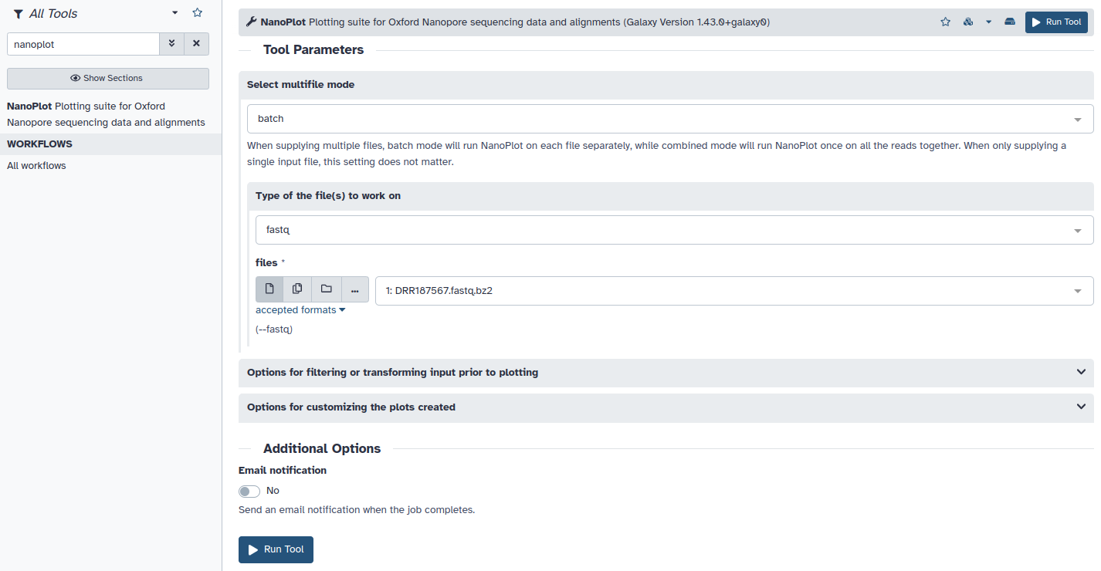
Galaxy - Nanoplot
https://github.com/wdecoster/NanoPlot

Slide 75
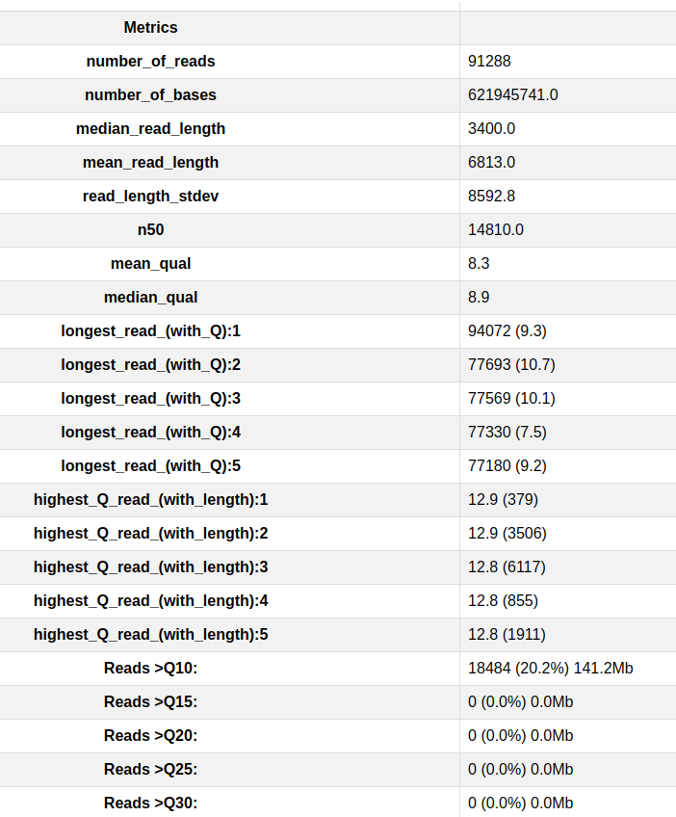
Galaxy - Nanoplot summary statistics
N50: at least half of the nucleotides in the assembly belongs to contigs with the N50 length or longer
Mean read length
Q scores
https://github.com/wdecoster/NanoPlot

Slide 76
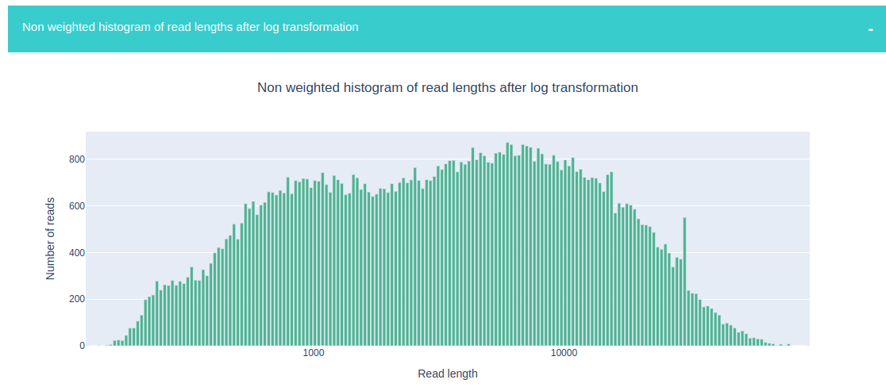
Galaxy - Nanoplot plots
https://github.com/wdecoster/NanoPlot

Slide 77
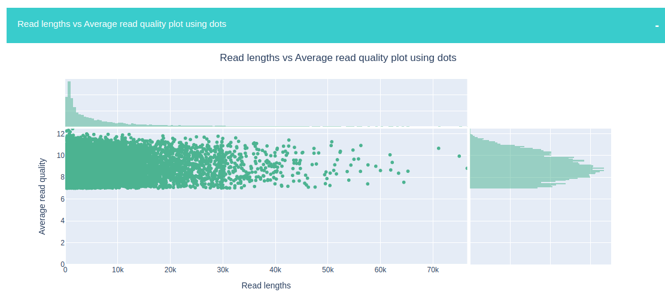
Galaxy - Nanoplot plots
https://github.com/wdecoster/NanoPlot

Slide 78
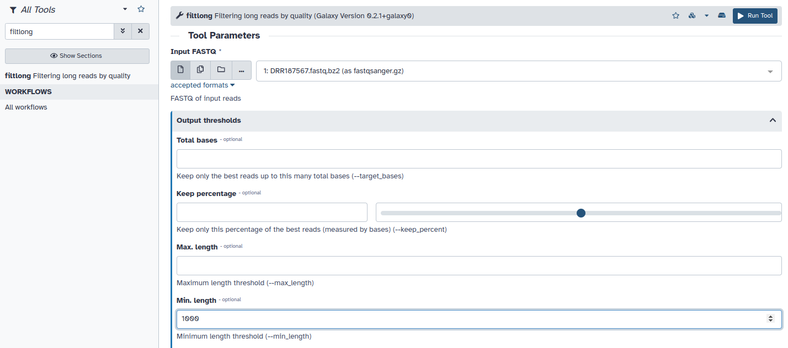
Galaxy - filtlong
Leave default or change minimum length to 1000
https://github.com/rrwick/Filtlong

Slide 79
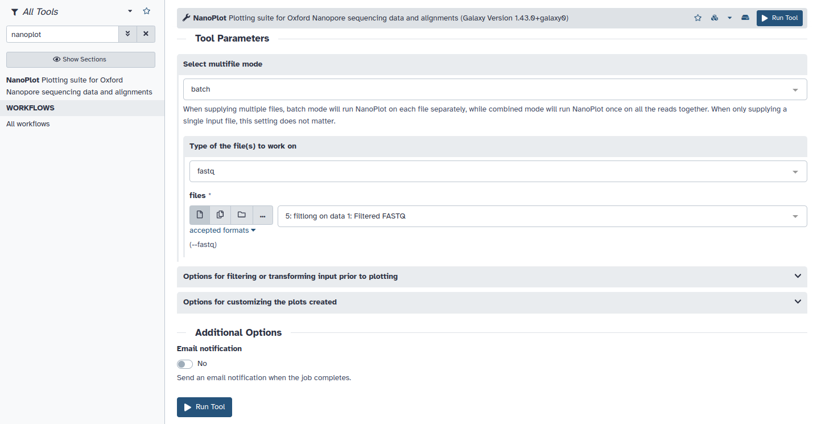
Galaxy - Nanoplot again
https://github.com/wdecoster/NanoPlot

Slide 80

Galaxy - Nanoplot summary statistics
https://github.com/wdecoster/NanoPlot

Slide 81

Galaxy - Nanoplot plots
https://github.com/wdecoster/NanoPlot

Slide 82

Galaxy - Nanoplot plots
https://github.com/wdecoster/NanoPlot

Slide 83

Galaxy - Flye
Output:
Consensus FASTA
Assembly graph
https://github.com/mikolmogorov/Flye

Slide 84

Galaxy – Flye output
Output:
Consensus FASTA
Assembly graph
https://github.com/mikolmogorov/Flye

Slide 85

Galaxy – Flye output
Output:
Consensus FASTA
Assembly graph
https://github.com/mikolmogorov/Flye

Slide 86

Galaxy - QUAST
https://github.com/ablab/quast

Slide 87

Galaxy - QUAST
https://github.com/ablab/quast

Slide 88

Galaxy – QUAST output
https://github.com/ablab/quast

Slide 89

Galaxy – mlst
https://github.com/tseemann/mlst

Slide 90
Galaxy – mlst output
Output:
Single txt file
Symbol | Meaning | Length | Identity
n | exact intact allele | 100% | 100%
~n | novel full length allele similar to n | 100% | ≥ --minid
n? | partial match to known allele | ≥ --mincov | ≥ --minid
- | allele missing | < --mincov | < --minid
n,m | multiple alleles
https://github.com/tseemann/mlst

Slide 91

Galaxy - staramr
Output:
Lots of files
Summary.tsv
Detailed_summary.tsv
Results.xlsx
https://github.com/phac-nml/staramr

Slide 92

Galaxy – staramr output
https://github.com/phac-nml/staramr

Slide 93
QIBs Student Training
Bioinformatics Training for the MRC Microbes, Microbiomes, and Bioinformatics Doctoral Training Partnership at UEA
Updated every year
Unix, Sequencing, Genomic and Metagenomic and Functional analysis
https://mmbdtp.github.io/

Slide 94
Command line basics
Change locations (cd)
Current location (cwd/pwd)
Create files/folders (touch/mkdir)
Move files/folders (mv)
Delete files/folders (rm/rmdir) - this can be dangerous !
Online course:
https://www.codecademy.com/learn/learn-the-command-line

Slide 95

Software managers
Conda -https://docs.conda.io/projects/conda/en/latest/user-guide/getting-started.html
Easiest way to install software if you know command line basics
Create "environments" - install software
Avoids software clashes (different versions)
Software A v2
Software A v1
Software B
v1
Software C v3

Slide 96




Programming languages
https://pythonforbiologists.com/tutorial.html
Python - Spyder/Jupyter notebooks
R - RStudio
https://wesmckinney.com/book/
https://r4ds.had.co.nz/
https://ggplot2.tidyverse.org/

Slide 97

Conclusions
Finding an appropriate analysis and solution
You will run into issues/errors and need to troubleshoot
GitHub/Documentation/Online forums
Tutorials are everywhere

